Slide 1
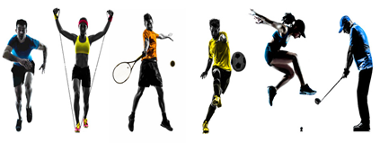
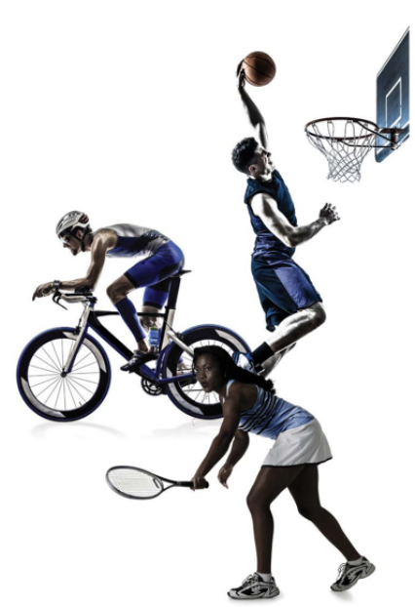

KS4
PE Department
GCSE PE Practical Moderation & Assessment
How can I improve my grades/ marks for my GCSE practical activities?
This booklet is to help you track, monitor, evaluate and develop/improve your grades/ marks for your GCSE PE practical activities.
How can I improve my skills in isolation performance & marks?
How can I improve my competitive competition performance & marks?
Is my Video or moderation performance evidence good enough?
What Activities can I be assessed in?
NAME:
CLASS:
PE TEACHER :

Slide 2
Use the checklist below to your knowledge and understanding of the practical component of the course.
 | 100% confident | More revision | I do not know this
I can identify how to improve my skills in isolation from the specification criteria?
I can identify how to improve my performance in competition from the specification criteria?
I know activities I can be assessed in for GCSE PE?
I know why fitness is important for my practical sports performance?
I know why fitness testing and training is important to improve practical performance?

Slide 3
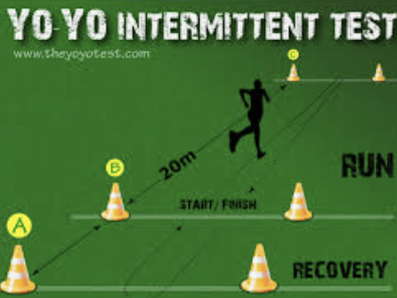
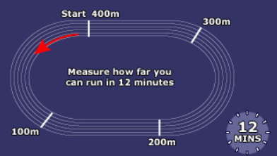
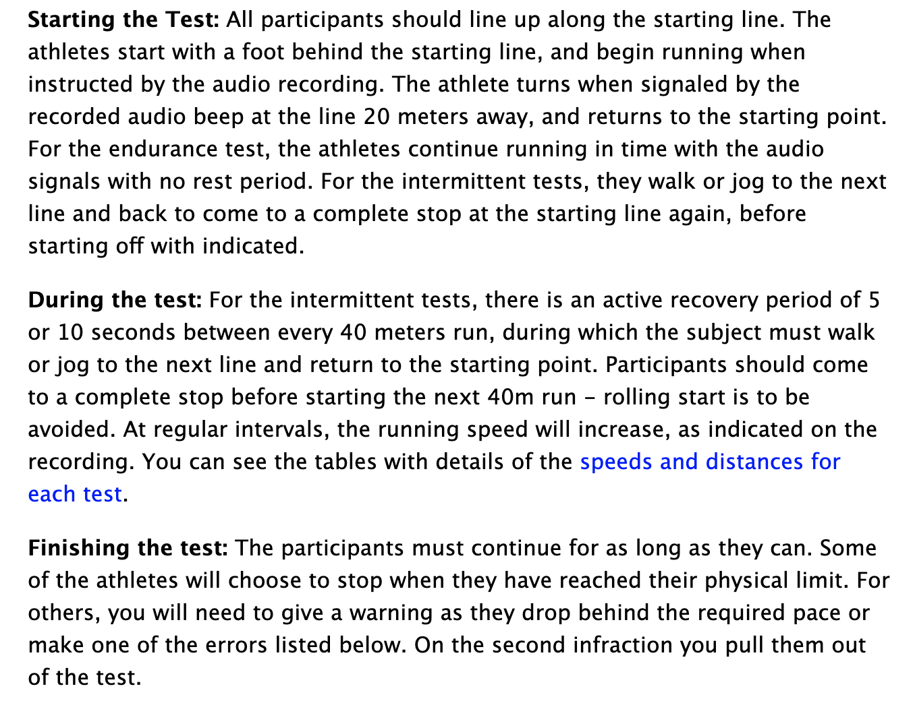
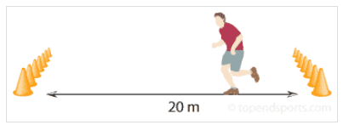
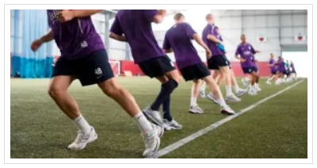
Fitness Training
Complete the Fitness training exercise/ tests and record results
Autumn Term 1
Fitness training/ test | Score/ time
MSFT
The Yo Yo Intermittent Test
Cooper Run
X Country

Slide 4
Fitness Testing Data: Complete tests and enter data then compare to normative data and enter scores
Test | Prep PEP Baseline Test Result | Score based on normative test data | Post PEP Test Result | Score based on normative test data
Sit and reach (CM)
Press up (How many 1min)
Sit up (How many 1min)
Sit & Reach (flexibility)
Consecutive Tennis ball Toss (How many in30 secs)
Standing Long Jump (How far M)
*Cooper run (How far M)
30m sprint (Time secs)
Step up Test (How many steps in 1mins)
Illinois agility run (Time Secs)
Grip Strength

Slide 5
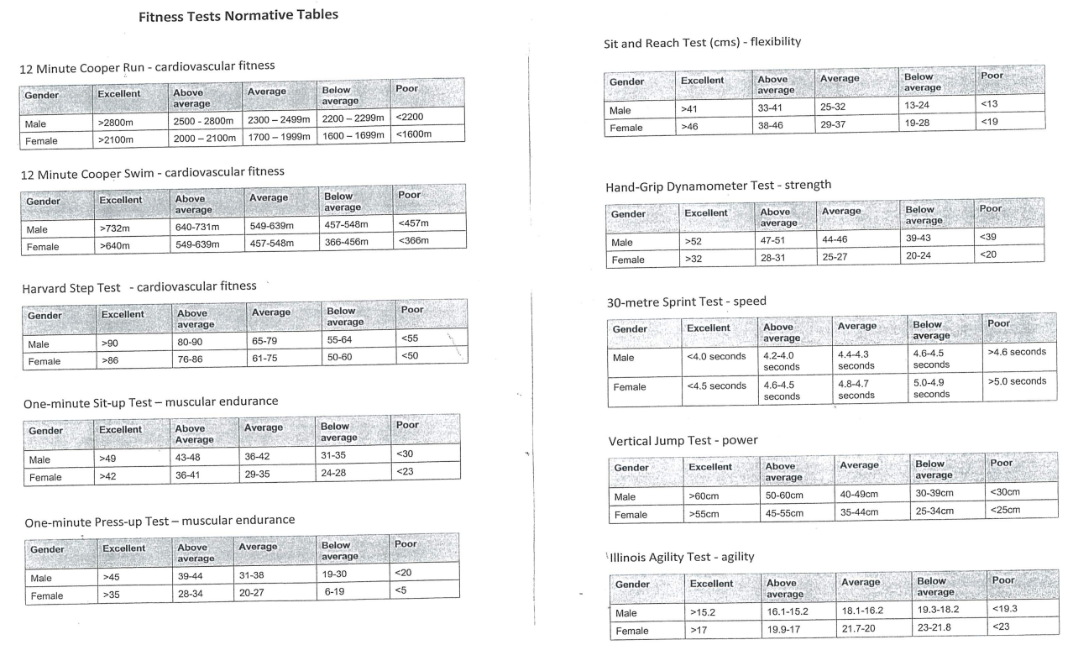
Fitness Testing Normative data
(See https://www.brianmac.co.uk for further information)

Slide 6
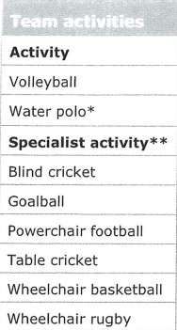
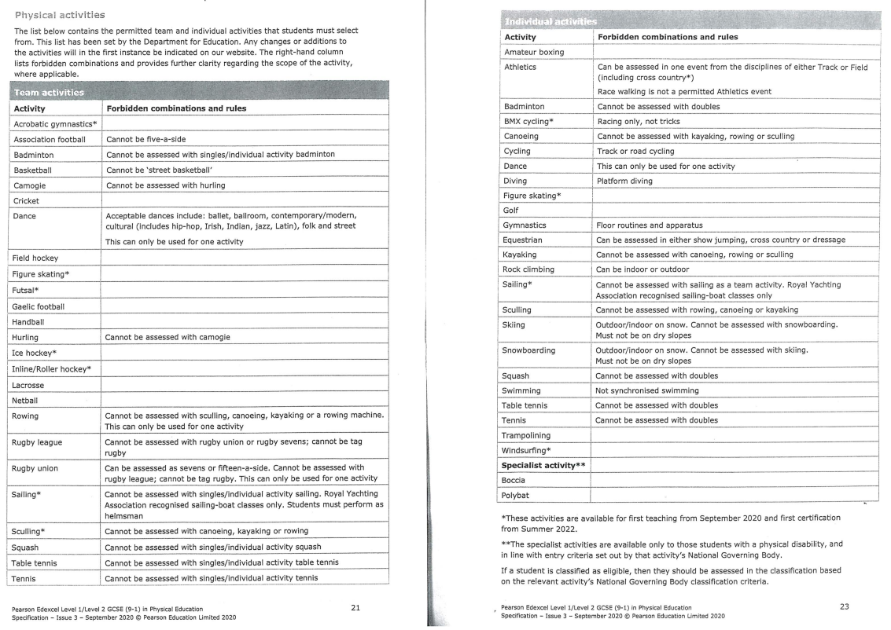
GCSE Practical Exam Activities Choice 30%

Slide 7
Year 10 Practical grades & DIRT feedback
(Task: fill in marks/ grades then look at specifications – Mark with green pen areas to improve & write in most relevant below in How to improve box below)
Autumn Term 1 | Skills in Isolation /10 | Competition performance /25 | Combined total /35
Fitness Testing & training | X | X | X
(Winter) Term1
Handball
How to improve:
(Winter) Term 2
Football
How to improve:
Netball
How to improve:
(Spring/ Summer) Term 3
Athletics
How to improve:

Slide 8
Year 11 Practical grades & DIRT feedback
(Task: fill in marks/ grades then look at specifications – Mark with green pen areas to improve & write in most relevant below in How to improve box below)
Autumn Term 1 | Skills in Isolation /10 | Competition performance /25 | Combined total /35
Fitness Testing & training | X | X | X
(Winter) Term1
Handball
How to improve:
(Winter) Term 2
Football
How to improve:
Netball
How to improve:
(Spring/ Summer) Term 3
Athletics
How to improve:

Slide 9
Alternative Sports Activities Practical grades
Alternative Activities Outside school (video Evidence) | Skills in Isolation /10 | Competition performance /25 | Combined total /35
Rugby
Tennis
Basketball
Dance
Equestrian
Cricket
Swimming
Feedback/ Development

Slide 10
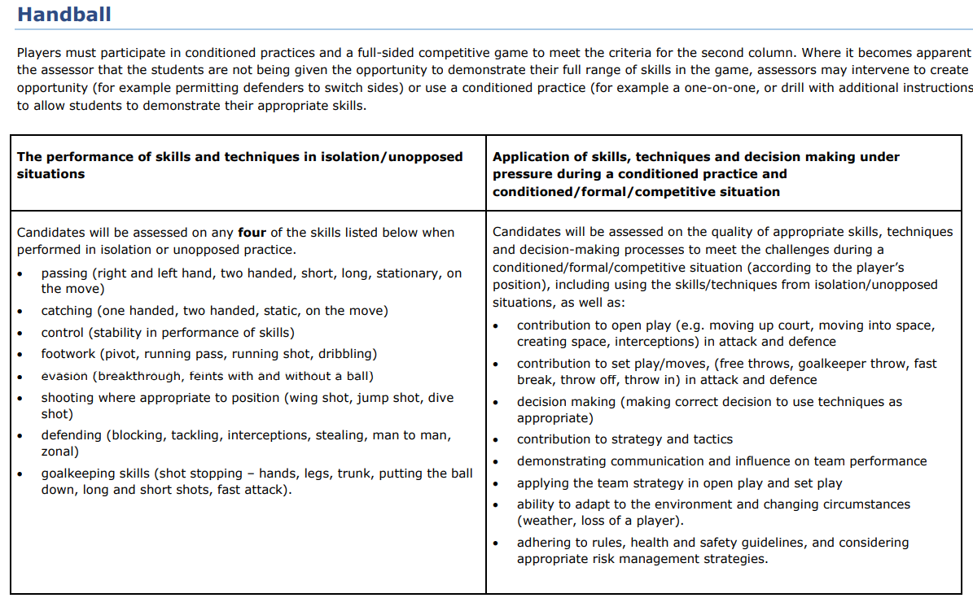
Sports Specifications: Handball

Slide 11
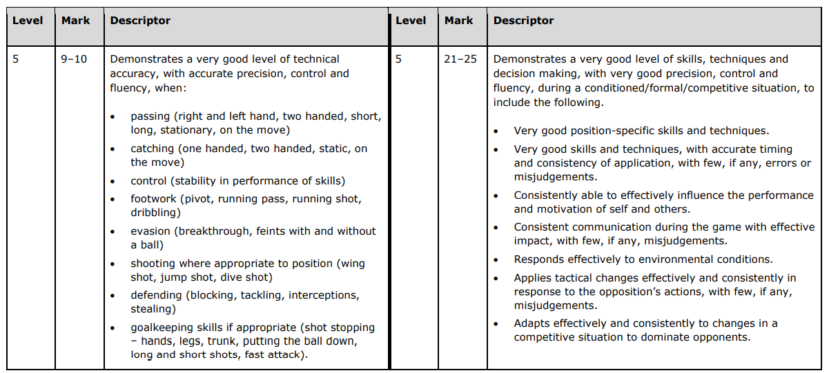
Sports Specifications Handball

Slide 12
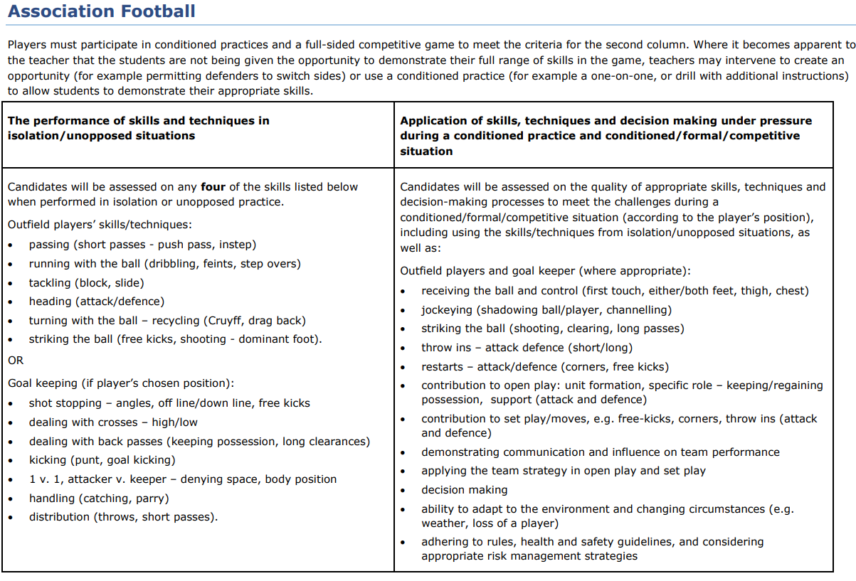
Sports Specifications: Association Football

Slide 13
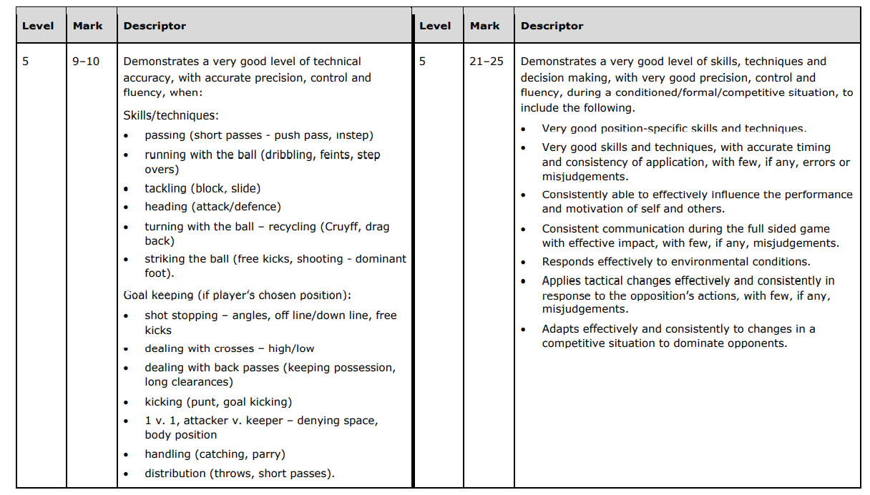
Sports Specifications: Football

Slide 14
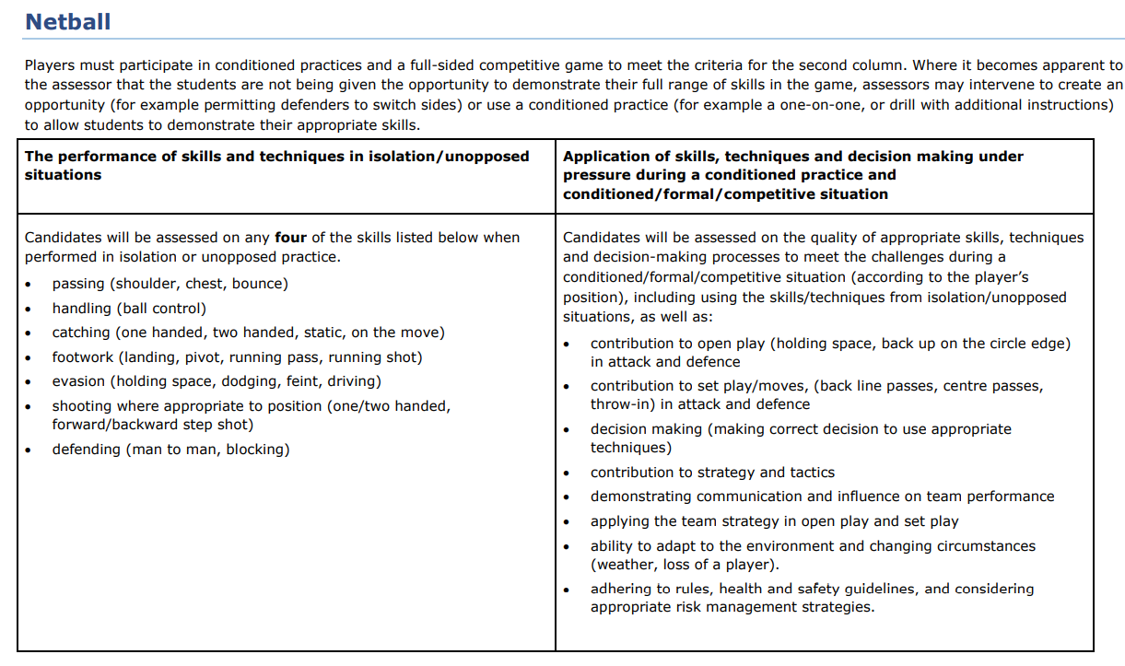
Sports Specifications: Netball

Slide 15
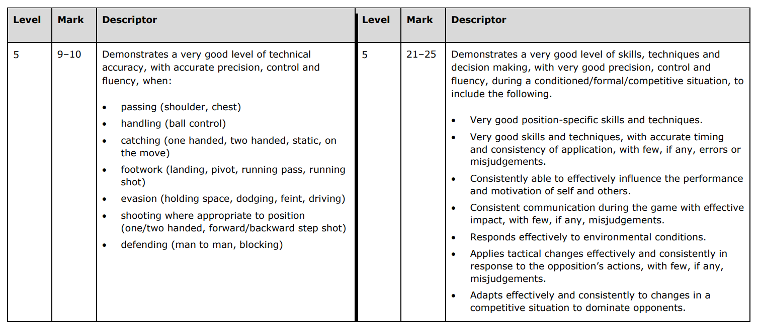
Sports Specifications: Netball

Slide 16
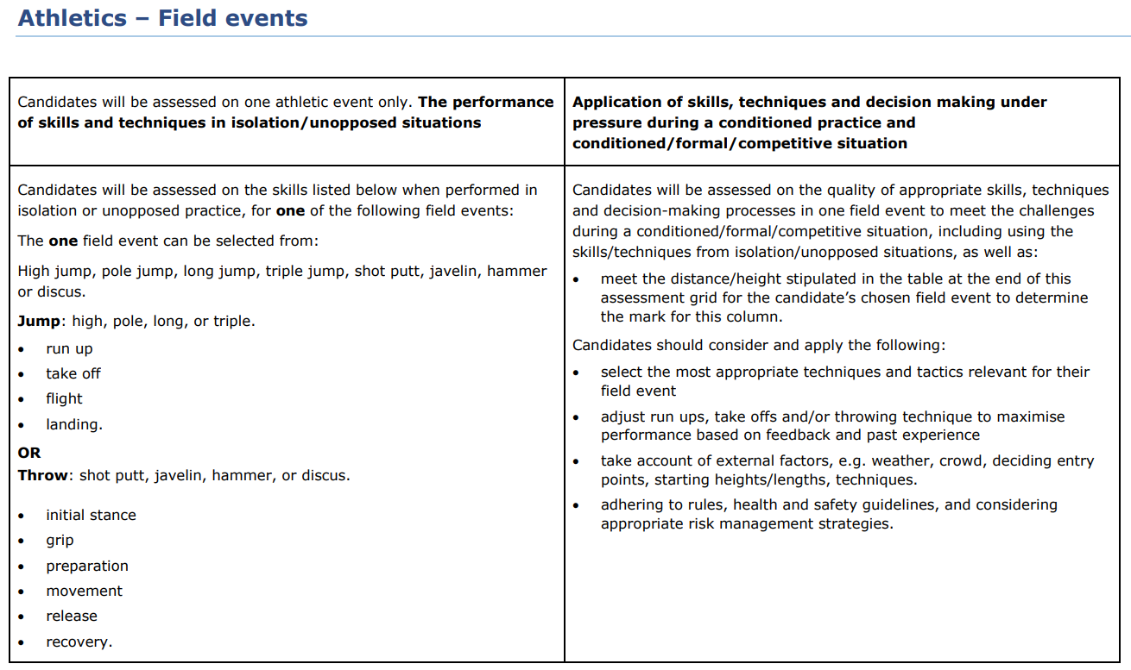
Sports Specifications: Athletics Field

Slide 17
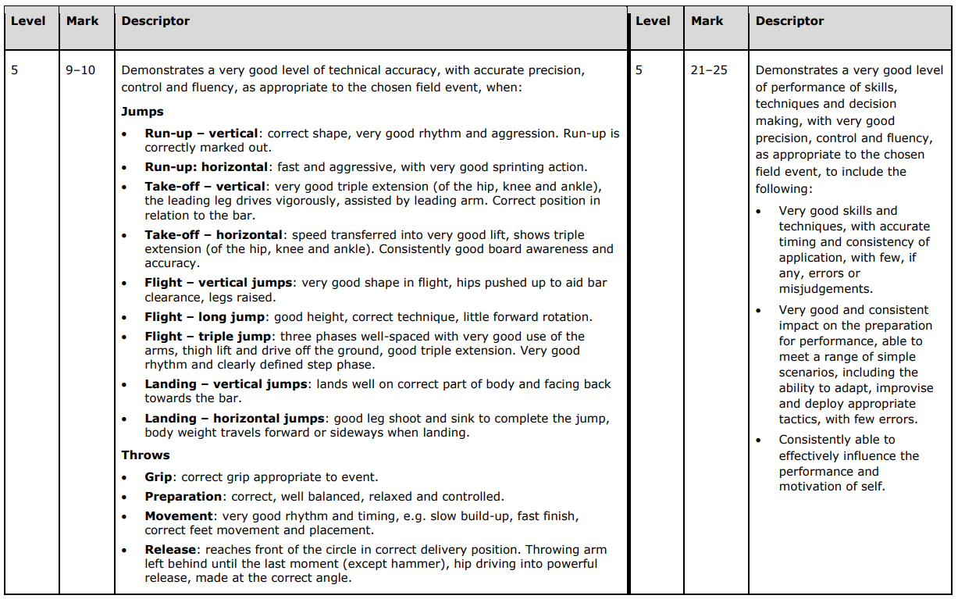
Sports Specifications: Athletics field

Slide 18
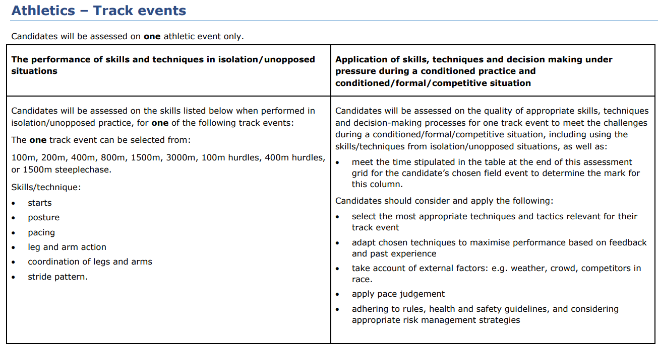
Sports Specifications: Athletics Track

Slide 19
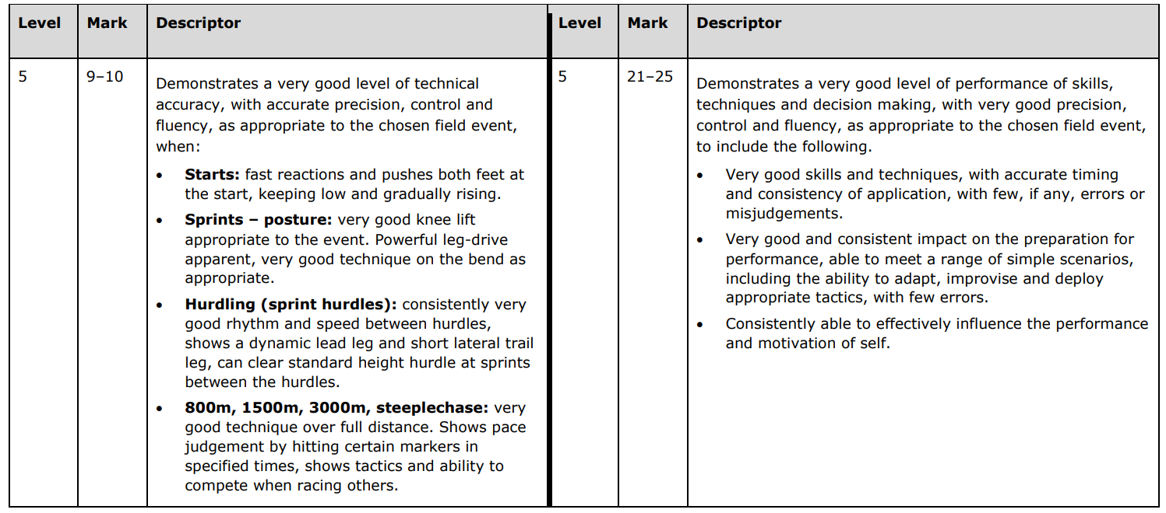
Sports Specifications: Athletics Track

Slide 20
Practical Sports Overview
Sport | Skills in Isolation | Competitive performance
Sport1:
Sport 2:
Sport 3:
Total Score(s)

