Slide 1
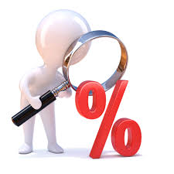
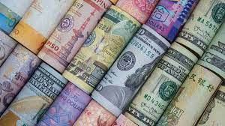
Year 8 Finance Project
Aim – to make the most amount of money by either, buying, selling, borrowing and investing
In this project you will be learning about percentages, exchange rate, bank account, loans, shares and trading.

Slide 2
Teacher guidance - Please be selective and adapt the lessons to the needs of your students
Lesson | Lesson content
1 | Teach students the skills required to complete the project. Teach Percentage increase and decrease Buying prices, selling prices, profit and loss Discuss simple interest/compound interest – consider ability of class
2 | Teach currency conversion US$ to £ and £ to US$ Convert between pounds and the Euro Conversion problems – consider ability
3 | Students get into teams of 3 or 4, assign a manager and decide on how to spend £1000. They must invest in a bank, buy bananas, coffee or oranges. Buying and selling shares is a choice. They can borrow more money if they want to invest more. Once students have decided what they are spending their money on they fill in the sheet and work out how much they would have by the end of the year (1 day is a year for savings and borrowing). This they can so next lesson if there isn’t much time in this lesson. Lower ability sets may just focus on saving in banks and buying and selling just one of the commodities.
4 or more if you wish. Each lesson can be a trading year. | In the first half of the lesson, students should work out how much money they made from yesterday’s decisions. If they have made more money they can invest this money. Students spend time investing there money again (share prices will have changed). Towards the end of the lesson students are given the change in share price, students calculate how much money they have gained or lost. Plenary – Students work out the amount of money they have at the end of the two days(2 years) Discuss the “good/bad/risky” financial decisions

Slide 3
Lesson 1
Starter
L.O Work out a percentage of a number and percentage profit and loss. Extension – Explore simple and compound interest
10% =
20% =
1% =
5% =
25% =
300 = 100%
3% =
30% =
35% =
93% =
65% =
56% =

Slide 4
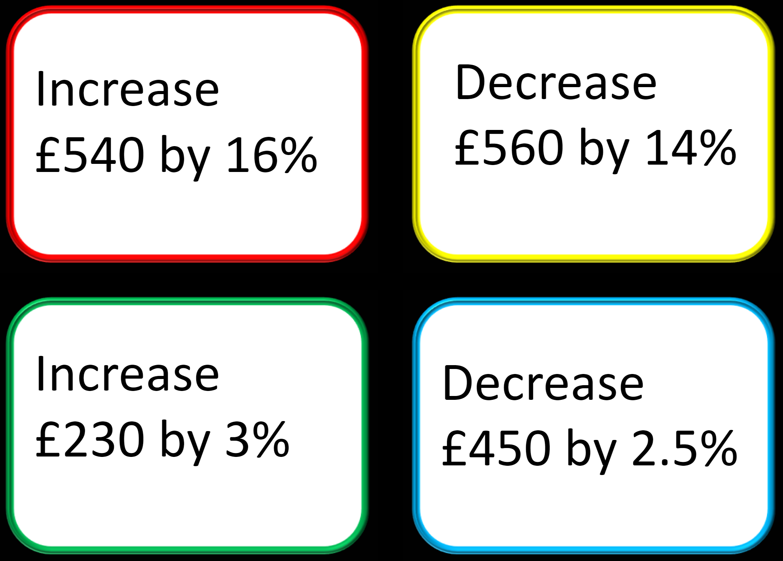
Percentage increase/decrease
If you invest £500 in a bank account and the bank pays you 3% interest per year. How much money will you have after 1 year? Show your methods.
If you invest £750 in a bank account and the bank pays you 4% interest. How much money will you have after 1 year? Show your methods.
If you invest £2500 in a bank account and the bank pays you 5% interest. How much money will you have after 2 year? Show your methods.

Slide 5
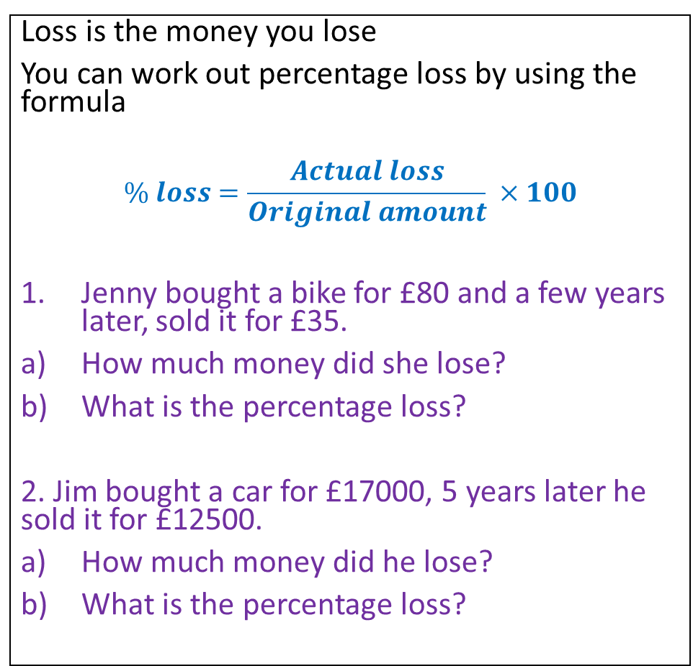
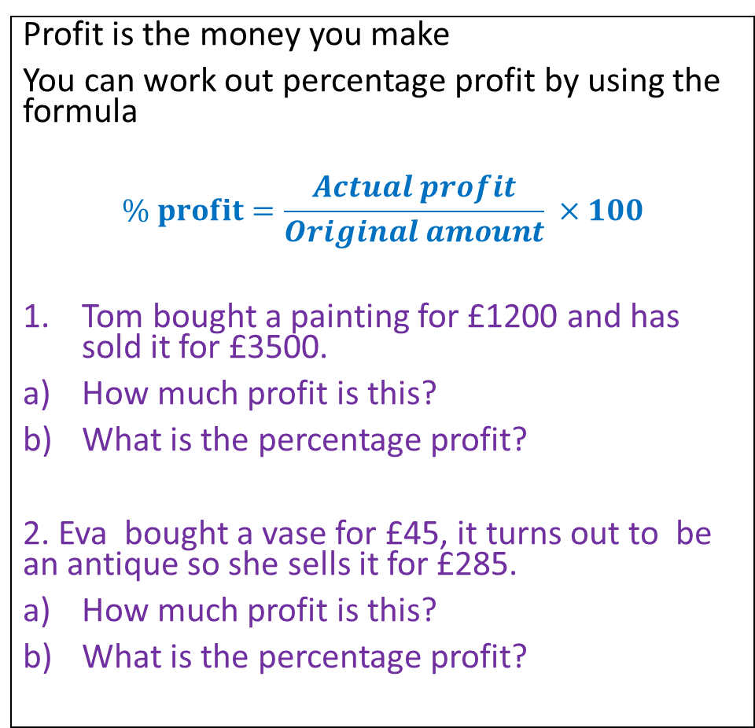
Profit and loss
Profit is the money you make
You can work out percentage profit by using the formula
$$\% profit=\frac{Actual profit}{Original amount} ×100$$
Tom bought a painting for £1200 and has sold it for £3500.
How much profit is this?
What is the percentage profit?
2. Eva bought a vase for £45, it turns out to be an antique so she sells it for £285.
How much profit is this?
What is the percentage profit?
Loss is the money you lose
You can work out percentage loss by using the formula
$$\% loss=\frac{Actual loss}{Original amount} ×100$$
Jenny bought a bike for £80 and a few years later, sold it for £35.
How much money did she lose?
What is the percentage loss?
2. Jim bought a car for £17000, 5 years later he sold it for £12500.
How much money did he lose?
What is the percentage loss?

Slide 6
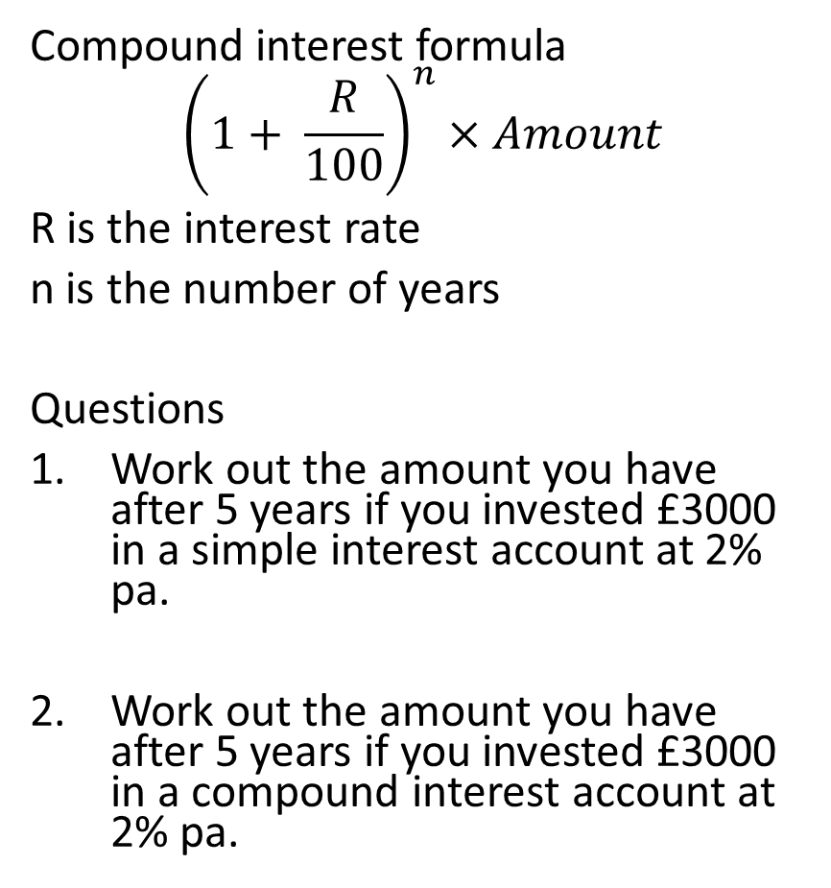
Simple interest and compound interest
Compound interest formula
$${\left(1+ \frac{R}{100}\right)}^{n}×Amount$$
R is the interest rate
n is the number of years
Questions
Work out the amount you have after 5 years if you invested £3000 in a simple interest account at 2% pa.
Work out the amount you have after 5 years if you invested £3000 in a compound interest account at 2% pa.
The difference between the two is that simple interest is a fixed amount of interest that is added on every year. This is based on the original amount.
With compound interest the amount you are calculating interest on, changes every year.
The interest is calculated for the first year and is then added on to the original amount to give the amount after the first year.
The interest for the second year is then calculated from the amount after the first year, which then gives a different amount of interest gained from the first year.

Slide 7
Lesson 2
L.O Use currency conversions
Starter
What currency conversion do you know?
Write down the ones that you know.
Which one is cheaper?
Trainers costing £30 or €30?
3. Which one is cheaper?
Jeans costing £65 or US$80
Explain how you know
Joe buys a car for £12000, sells it a year later for £9750. What is his percentage loss.
Kat invests £8000 for 5 years at 3.5% compound interest. How much money will she have after 5 years.
Notes:
Some conversions 20th June
£1=US$1.28
£1 = 1.17 Euro
£1 = AU $1.87
£1 = Indian rupee £105
https://www.oanda.com/currency-converter is a good website to use

Slide 8
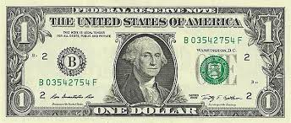
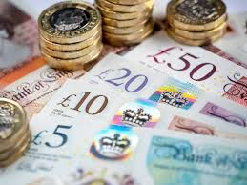
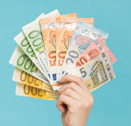
Convert the following currencies
Use the conversion £1 = US$ 1.28 to convert between Pounds and US dollars.
£10 =
£75 =
£250 =
£500 =
US$ 65 =
US$ 750 =
US$ 900 =
US$ 1500 =
Use the conversion £1 = €1.17 to convert between Pounds to Euros
£50 =
£85 =
£350 =
£500 =
€ 70 =
€ 750 =
€ 450 =
€ 1000 =

Slide 9
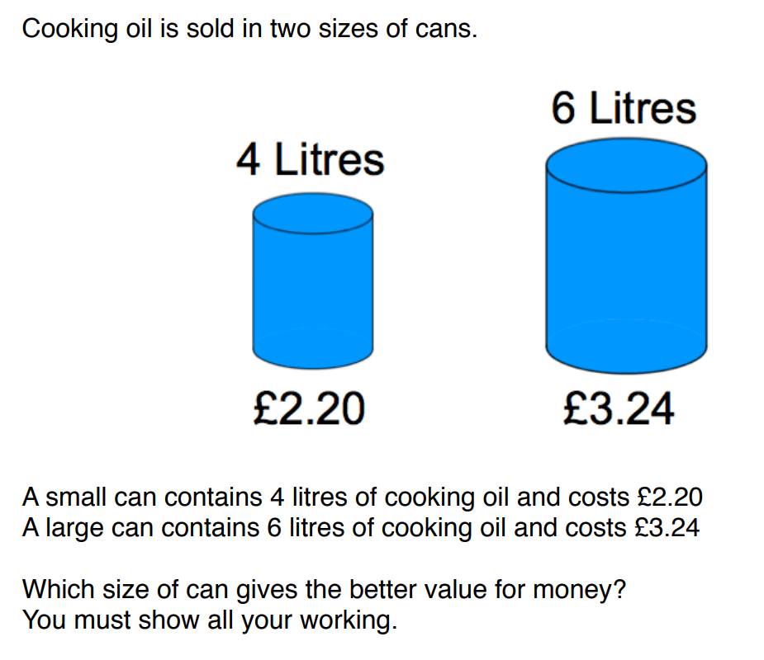
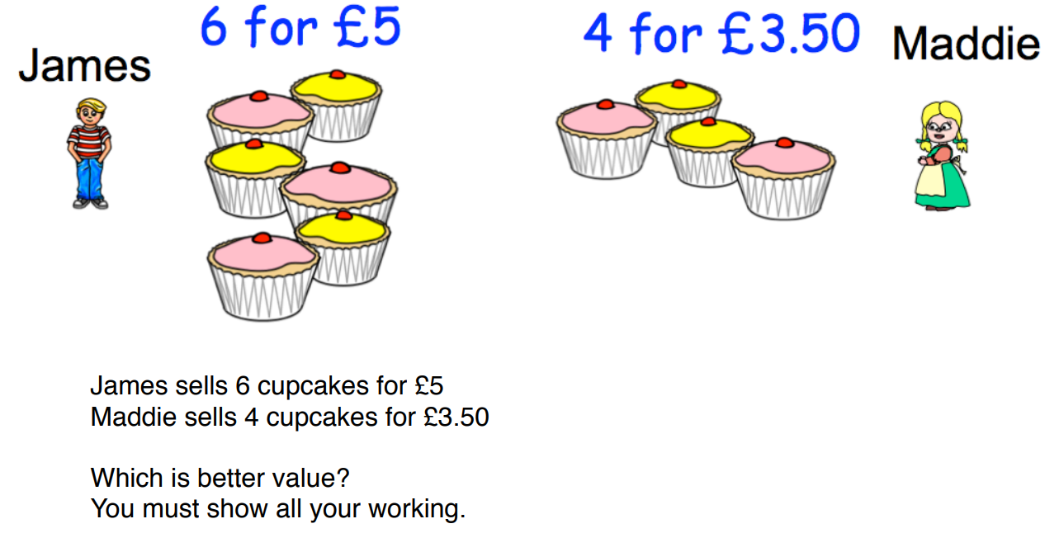
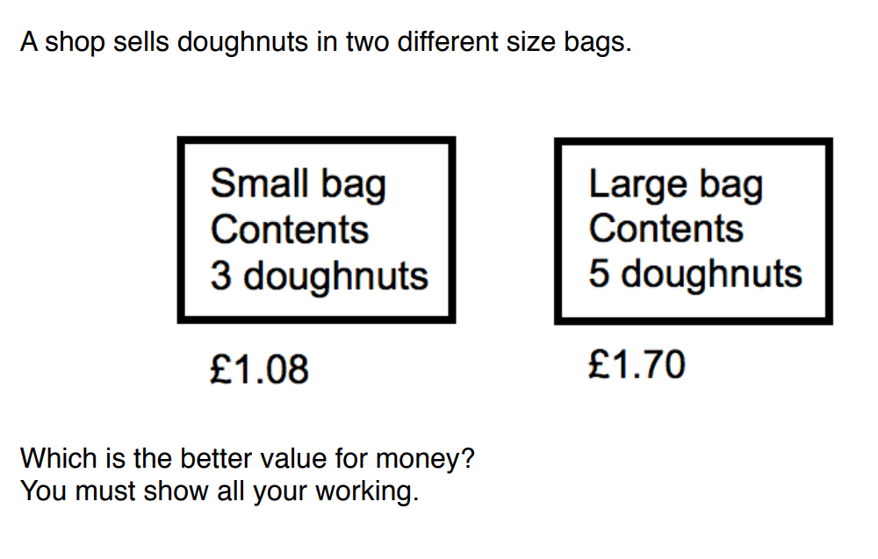
Work out the best buys

Slide 10
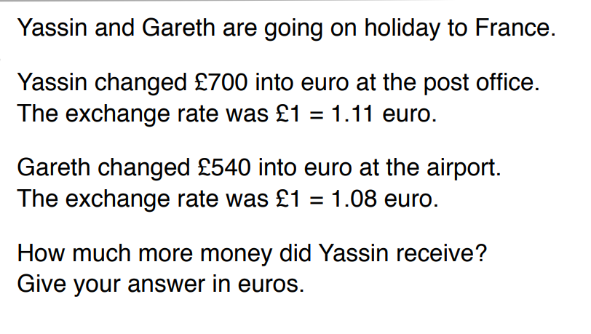
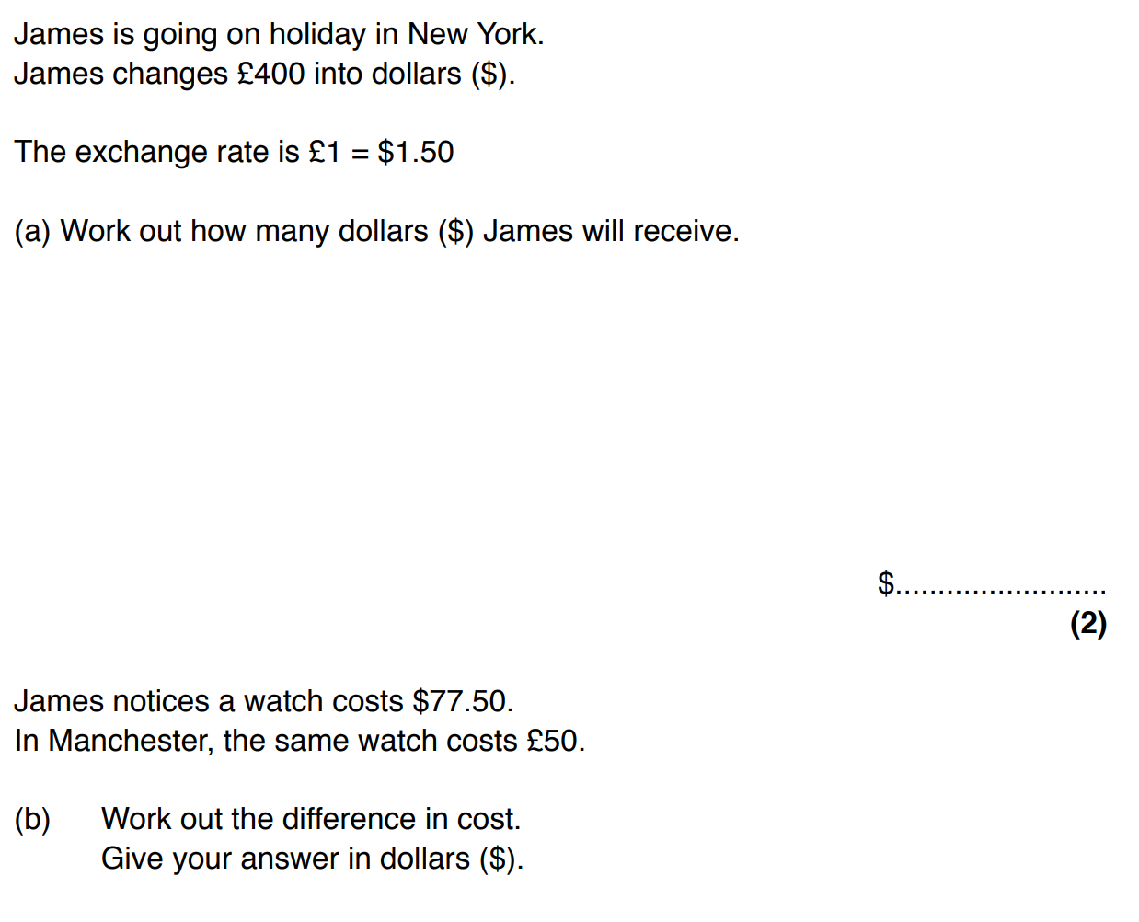
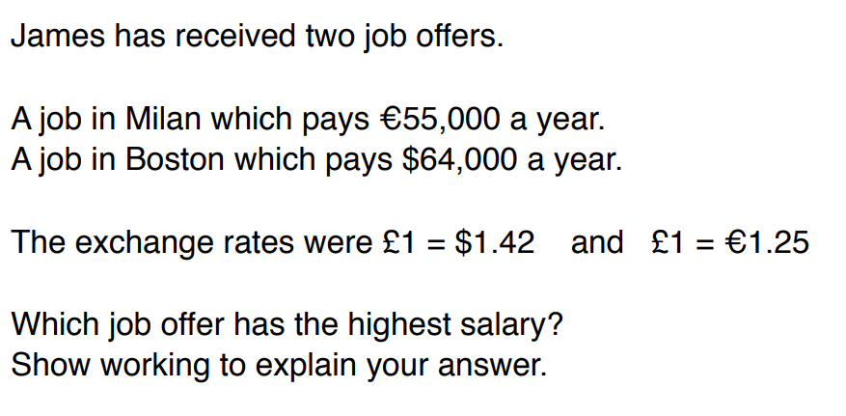
Exchange rates questions

Slide 11
L.O – To use your knowledge to maximise your profit. To make financial decisions.
Lesson 3
Team Challenge
You will be taking on this challenge over the next few lessons.
Get into groups of 3 or 4
Nominate a manager – this person will make the final decisions and direct the team.
The manager will need to make decisions on how you are going to spend your money.
Your aim is to make the most money.
You will start with a virtual £1000 and on your second day you can invest the money you made on day 1.

Slide 12
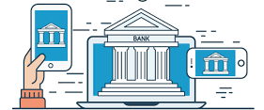
Your options
Save at a bank – this is secure, you will know exactly how much money you will make, however look carefully at the interest rates. You must save some money, minimum amount is £200
Buy and sell bananas, coffee, oranges – You will be given buying and selling prices, therefore, you will always make money as we will assume you sell everything you buy. You must invest some money in commodities, the minimum amount is £200
Buy and sell shares – This is risky as you could make money or lose money depending on the share price. The market could crash too! Investing in shares is optional.
Get a loan and invest it – You must make sure that the interest you pay is less than the money you make, otherwise there is no point in borrowing money. Getting a loan is optional.

Slide 13
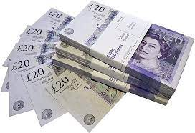
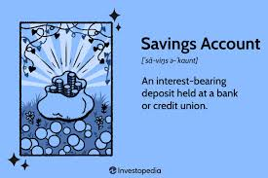
Savings options
Option 1
Instant access account, 3% p.a, minimum deposit £100
Option 2
Instant access account, 2% p.a, minimum deposit £1
Option 3
Instant access account, 3.5% p.a, minimum deposit £300
Option 4
Instant access account, 4.5% p.a, minimum deposit £500

Slide 14
Borrowing options
Borrow anything between £1000 and £5000. Make sure you calculate the interest as you will need to pay it back.
Borrow £500 at an interest rate of 5.4%
Borrow £1000 at an interest rate of 5.8%
Borrow £2000 at an interest rate of 4.9%
Borrow any amount between £1000 and £5000 at an interest rate of 4.5%

Slide 15
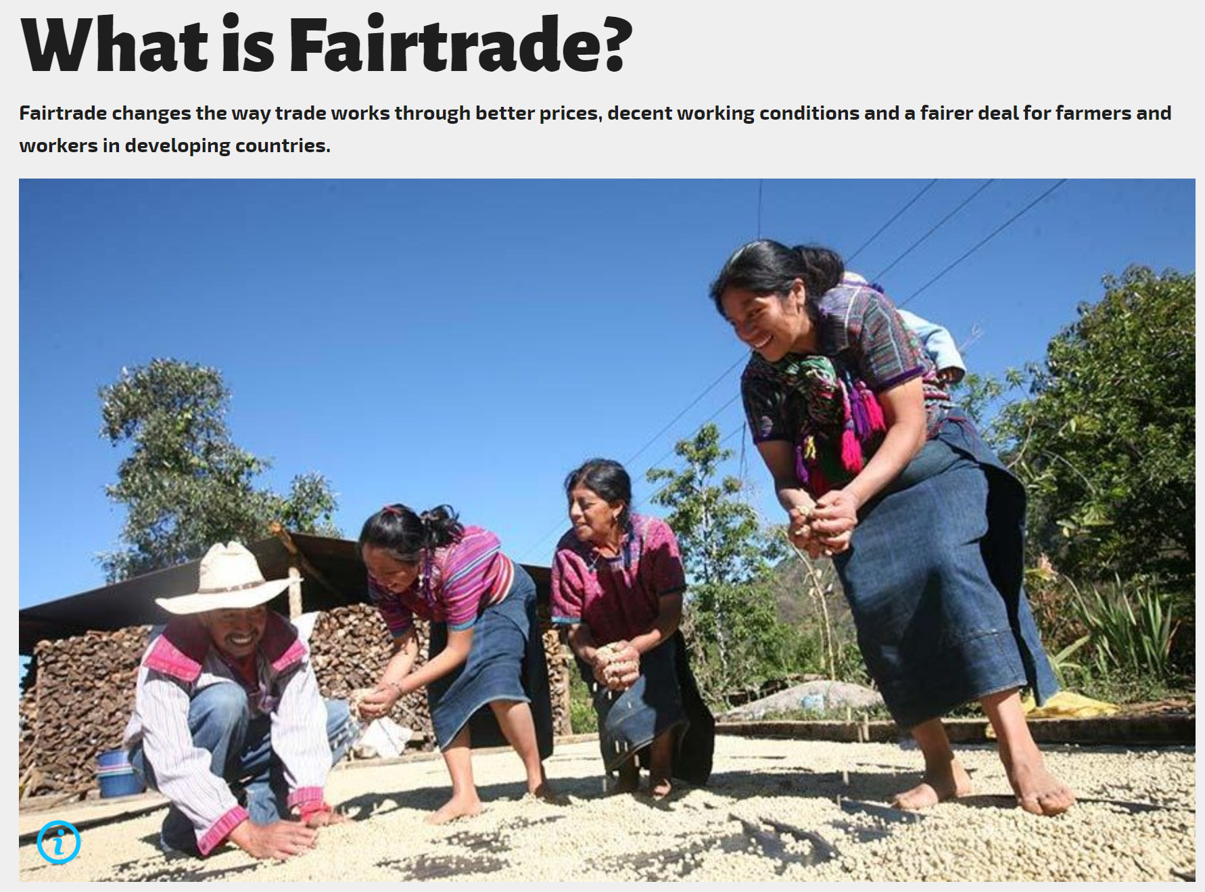
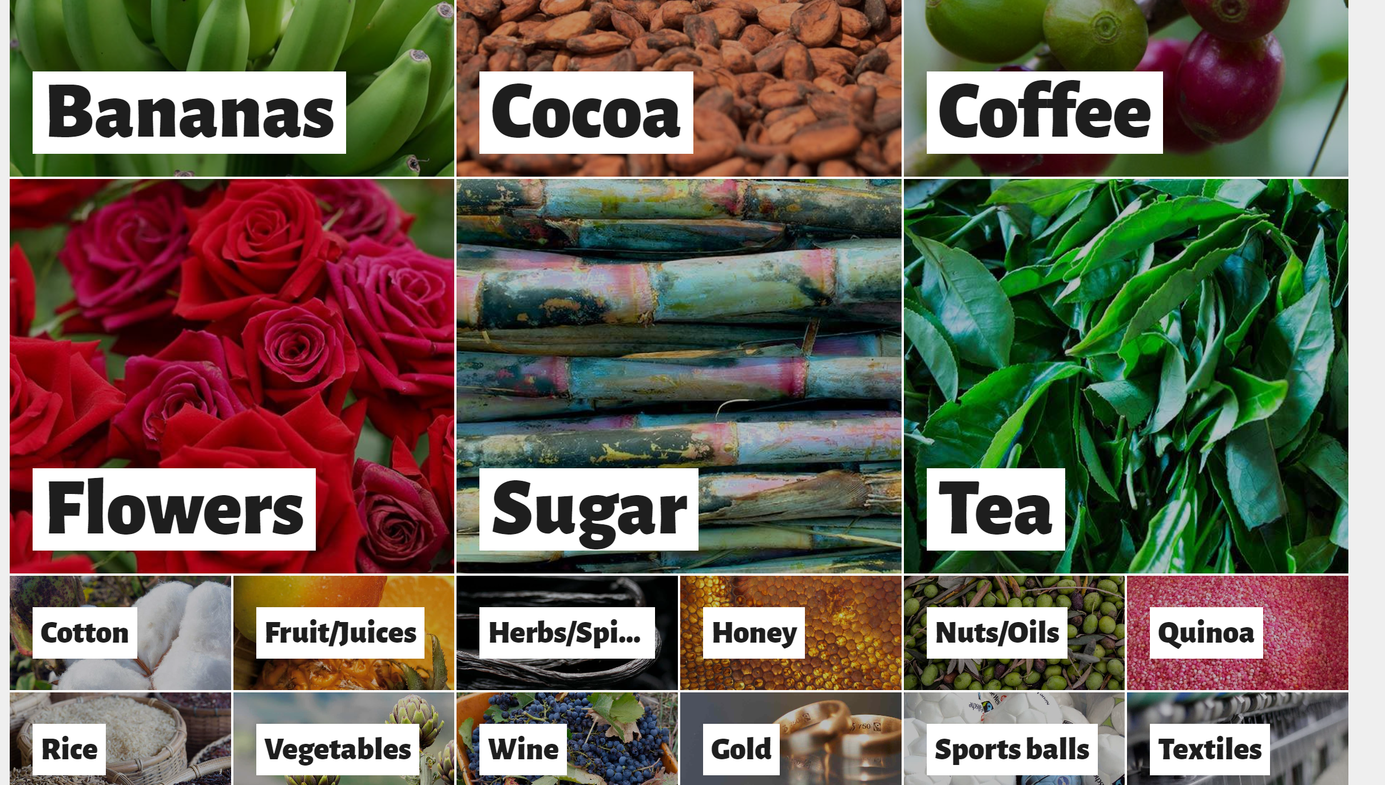
Fairtrade changes the way trade works through better prices, decent working conditions and a fairer deal for farmers and workers in developing countries.
Fairtrade's approach enables farmers and workers to have more control over their lives and decide how to invest in their future.
As a leader in the global movement to make trade fair, Fairtrade supports and challenges businesses and governments and connects farmers and workers with the people who buy their products.
By choosing Fairtrade, people can create change through their everyday actions. A product with the FAIRTRADE Mark means producers and businesses have met internationally agreed standards which have been independently certified.
Farmers and workers have a strong voice at every level of Fairtrade, from how they invest in and run their local organizations to having an equal say in Fairtrade’s global decision-making.

Slide 16
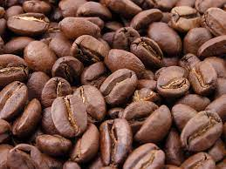

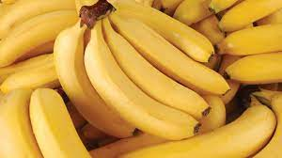
Buying and selling commodities
 | Buying price | Selling price
Coffee Beans from Columbia | US$ 3.74 per kg | £4.40 per kg £20 per 5kg
Coffee Beans (Fair trade) | US$ 3.80 per kg | £4.60 per kg £40 per 10kg
Bananas from Costa Rica | US$ 1.21 per kg | £1.45 per kg £28 per 20kg
Bananas (Fair trade) | £1.05 per kg | £1.70 per kg £20 per 10kg
Oranges from South America | US$ 1.45 per kg | £1.15 per kg
Oranges from Spain | €1.50 per kg | £1.90 per kg
Currency conversions £1 = US$ 1.28 £1 = €1.17

Slide 17
Share prices
Company | Buy | Past month change in price | Live selling price on Friday
Nike | US$ 113.59 | -1.17
Tesla | US$ 260.54 | +1.81
Netflix | US$ 431.96 | +66.6
Tesco | US$ 258.36 | -0.04
Amazon | US$ 125.49 | -1.27
HSBC | US$ 39.18 | +0.33
Vodafone | US$ 9.37 | -0.11
You can buy shares, however you will not know the selling price until the last trading day. This mean you could make money or you could lose money, it is a risk!
Share prices can go up or go down, the final selling price will be released on your final session.

Slide 18
End of Day 1
Work out how much money you would have made from day 1
From savings?
From buying and selling commodities?
From buying and selling shares?
Did your borrow any money? How much interest do you have to pay?
What is your total at the end of day 1?
What did you learn for day 1? What might you do differently during day 2 of trading?

Slide 19
Share prices at the close of lesson 1
Company | Buy | Past month change in price | Live selling prices at the end of day 1
Nike | US$ 113.59 | -1.17 | US$ 111.45
Tesla | US$ 260.54 | +1.81 | US$ 250.23
Netflix | US$ 431.96 | +66.6 | US$ 440.96
Tesco | US$ 258.36 | -0.04 | US$ 245.36
Amazon | US$ 125.49 | -1.27 | US$ 128.66
HSBC | US$ 39.18 | +0.33 | US$ 44.23
Vodafone | US$ 9.37 | -0.11 | US$ 11.54
You can buy shares, however you will not know the selling price until the last trading day. This mean you could make money or you could lose money, it is a risk!
Share prices can go up or go down, the final selling price will be released on your final session.

Slide 20
Day 2 of Investing
Lesson 4
Work out how much money you have made from day 1.
Invest your money in the same way as last lesson.
The only thing that has changed is the share prices – see table below
Company | Buying price
Nike | US$ 111.45
Tesla | US$ 250.23
Netflix | US$ 440.96
Tesco | US$ 245.36
Amazon | US$ 128.66
HSBC | US$ 44.23
Vodafone | US$ 11.54

Slide 21
Share prices at the close of day 2
Company | Buy | Live selling prices at the end of day 2
Nike | US$ 111.45 | US$ 103.75
Tesla | US$ 250.23 | US$ 220.40
Netflix | US$ 440.96 | US$ 398.46
Tesco | US$ 245.36 | US$ 245.36
Amazon | US$ 128.66 | US$ 120.80
HSBC | US$ 44.23 | US$ 50.23
Vodafone | US$ 11.54 | US$ 20.84
How much have you made/lost from buying and selling shares?

Slide 22
End of Day 2
Work out how much money you would have made from day 2
From savings?
From buying and selling commodities?
From buying and selling shares?
Did your borrow any money? How much interest do you have to pay?
What is your total at the end of day 2?
What have you learnt from this project?

Slide 23
Conclusion
Our group made ……………. from day 1.
We made the most money by investing in …………………
On day 2 we decided to …………………………………………………………..
Because ………………………………………………
If we continued this process we would…………………………………………….
How much money did you finish with?
Did you buy shares? Why?
Did you borrow money? Why?
Did you save money?
Which commodities did you invest in and why?

Slide 24
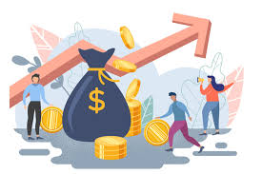
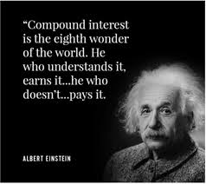

How will you invest in your future?

