Slide 1
Turning Points Section 1 – The discovery of the electron
The discovery of the electron and the determination of e/m and e took the subject forward through important experimental work by Thomson and Millikan. Further work on electron beams led to support for relativity and the discovery of electron diffraction. Recent 'Millikan' experiments have unsuccessfully sought evidence for fractional charge.

Slide 2
1.1 Cathode Rays

Slide 3
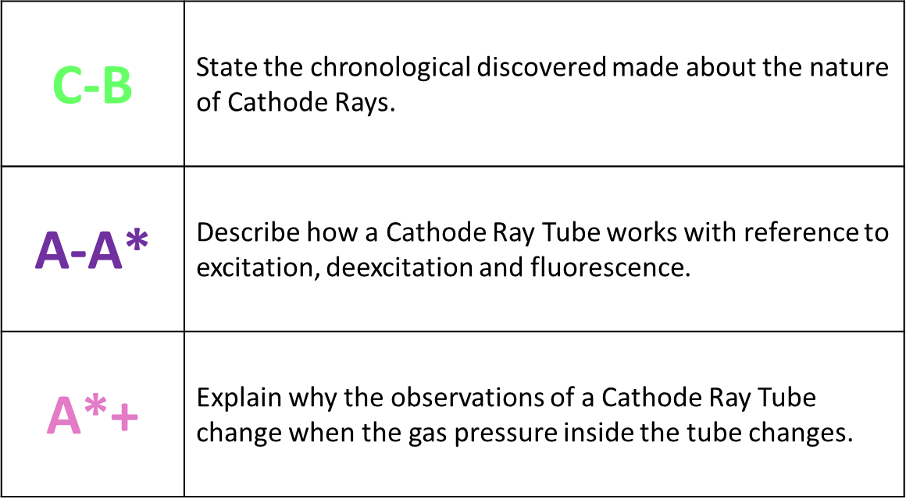

A LEVEL PHYSICS Year 2
Turning Points: 1.1 – Cathode Rays
A*
A
B
C

Slide 4

Connection
What did the Alpha Scattering experiment lead to the discovery of?
The ground state, first and second energy levels of a hydrogen atom have values of -13.6eV, -3.41eV and -1.51eV respectively. What is the minimum wavelength of photon that could be emitted during a de-excitation between these energy levels?
What is the specific charge on an alpha particle?
Define Potential Difference.
5. For the hydrogen atom in Q2, what is the minimum speed of electron required to ionise the atom through collision?

Slide 5
Connection
What did the Alpha Scattering experiment lead to the discovery of? The discovery of the nucleus.
The ground state, first and second energy levels of a hydrogen atom have values of -13.6eV, -3.41eV and -1.51eV respectively. What is the minimum wavelength of photon that could be emitted during a de-excitation between these energy levels? Using E=hf… 1.03x10⁻⁷m
What is the specific charge on an alpha particle? +2e
Define Potential Difference.
Work done per unit charge
5. For the hydrogen atom in Q2, what is the minimum speed of electron required to ionise the atom through collision?
Using KE equation… v=2.2x10⁶ms⁻¹

Slide 6
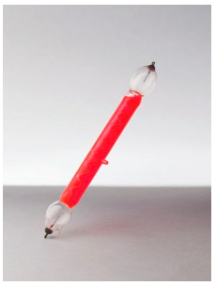
Activate: Cathode rays
In the late 1860s, it was popular to show glass tubes filled with a gas which could be made to glow (Geissler tubes).
When a large voltage was applied to the electrodes and electrical current passed through the gas.
The gas glowed due to the ionisation and subsequent recombination of the molecules in the gas (this was the beginning of the technology behind neon lighting signs)

Slide 7
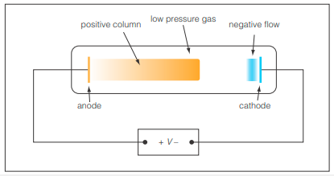
Activate: Cathode rays
10 years later, William Crookes made discharge tubes with a much lower pressure. He used a vacuum pump to remove the air inside the tubes. Faraday observed that the glow appeared to be brightest at the cathode.

Slide 8
So why do we get light at the cathode?
The voltage applied to the tube is so high that some of the gas atoms in the tube are ionised because the electric field pulls electrons out of them.
Positive ions created near the cathode are attracted onto the cathode surface, causing free electrons from the cathode surface to be emitted.
These electrons are accelerated towards the anode and collide with gas atoms causing them to be ionised.
The glowing gas near the cathode, the ‘negative glow’, is due to photons emitted when some of the positive ions and electrons produced by ionisation recombine.

Slide 9
So why do we get light at the anode?
Some of the electrons pulled out of the gas atoms do not recombine and are attracted to the anode and therefore further move away from the cathode - hence the term ‘cathode rays’ was used to describe them.
These electrons move towards the anode and cause excitation by collision of gas atoms in the tube.
The positive column of glowing gas is due to de-excitation of these excited gas atoms.
The processes of recombination and de-excitation result in the emission of photons of visible and ultraviolet light.

Slide 10
Activate: Cathode rays
This glow was called the cathode ray, but scientists were unsure as to what it was made up of until JJ Thomson showed that cathode rays:
Have a mass, which he measured
Have a negative charge
Have the same properties no matter what gas is used in the discharge tube
Have a very large charge to mass ratio
Soon after this, it was concluded that all atoms contained these cathode ray particles, and they were renamed electrons.
https://www.youtube.com/watch?v=4QAzu6fe8rE

Slide 11
Activate: How does a discharge tube glow?
The high potential difference across the discharge tube will pull electrons off the gas atoms, forming ion and electron pairs.
The positive gas ions are accelerated towards the cathode and when they collide with it they release even more electrons.
The electrons are accelerated along the tube (because the gas is at low pressure, the electrons are accelerated to high speeds) and collide with gas atoms causing them to become excited. The atoms will quickly de-excite and release photons of light.
The glow is brightest at the cathode because here the gas ions and electrons can recombine and emit photons of light.

Slide 12
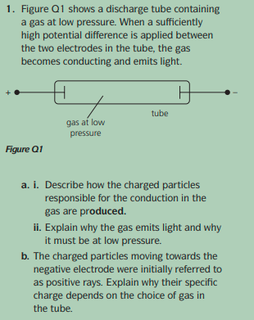

Slide 13
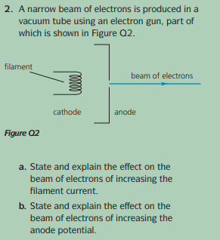

Slide 14
Demonstrate:
Create a flow chart to show the key points behind how a discharge tube glows…

Slide 15
Consolidate
Cathode ray exam questions

