Slide 1

Starter
How were women treated in the 1800s - 1900s?
How has that changed in 2024?
Think of a woman you admire/look up to – what is it about her that inspires you to be a better person?
What techniques would you use in a letter?

Slide 2

to write a letter of appreciation to an inspiring woman for International Women's Day

Slide 3
WHY DO WE CELEBRATE IT?
International Women's Day is a fantastic opportunity to celebrate the achievements of women globally and to advocate for gender equality. It's a reminder of the progress we've made and the work still to be done to create a more inclusive and equitable world for everyone.

Slide 4
“Here's to the incredible women who continue to break barriers, inspire change, and shape the world around them. Happy International Women's Day!”
“As we celebrate the strength and resilience of women around the world, may we continue to uplift, empower, and support each other.

Slide 5

Create a plan: Mind map or list Which woman do you admire/look up to? What do you like about her? What does she do that inspires you? What qualities does she have that you hope to develop or learn? When you grow up, you want to be like her because... You appreciate her because.. Remember to plan for three paragraphs – what will you include in each one?

Slide 6
Write your letter.
Create a first draft in your book.
Edit and improve.
What techniques can you include to make it better?
Create a final draft – it would be nice for you to share these with the person you have written them for so you could write on lined paper. You can also make envelopes and get creative!

Slide 7
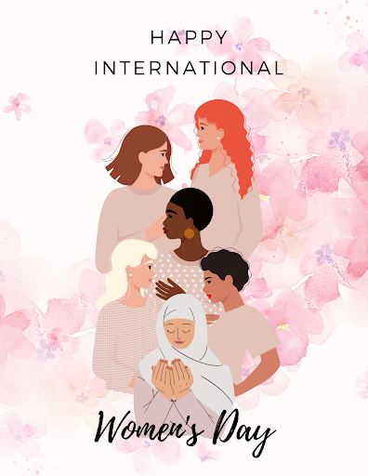
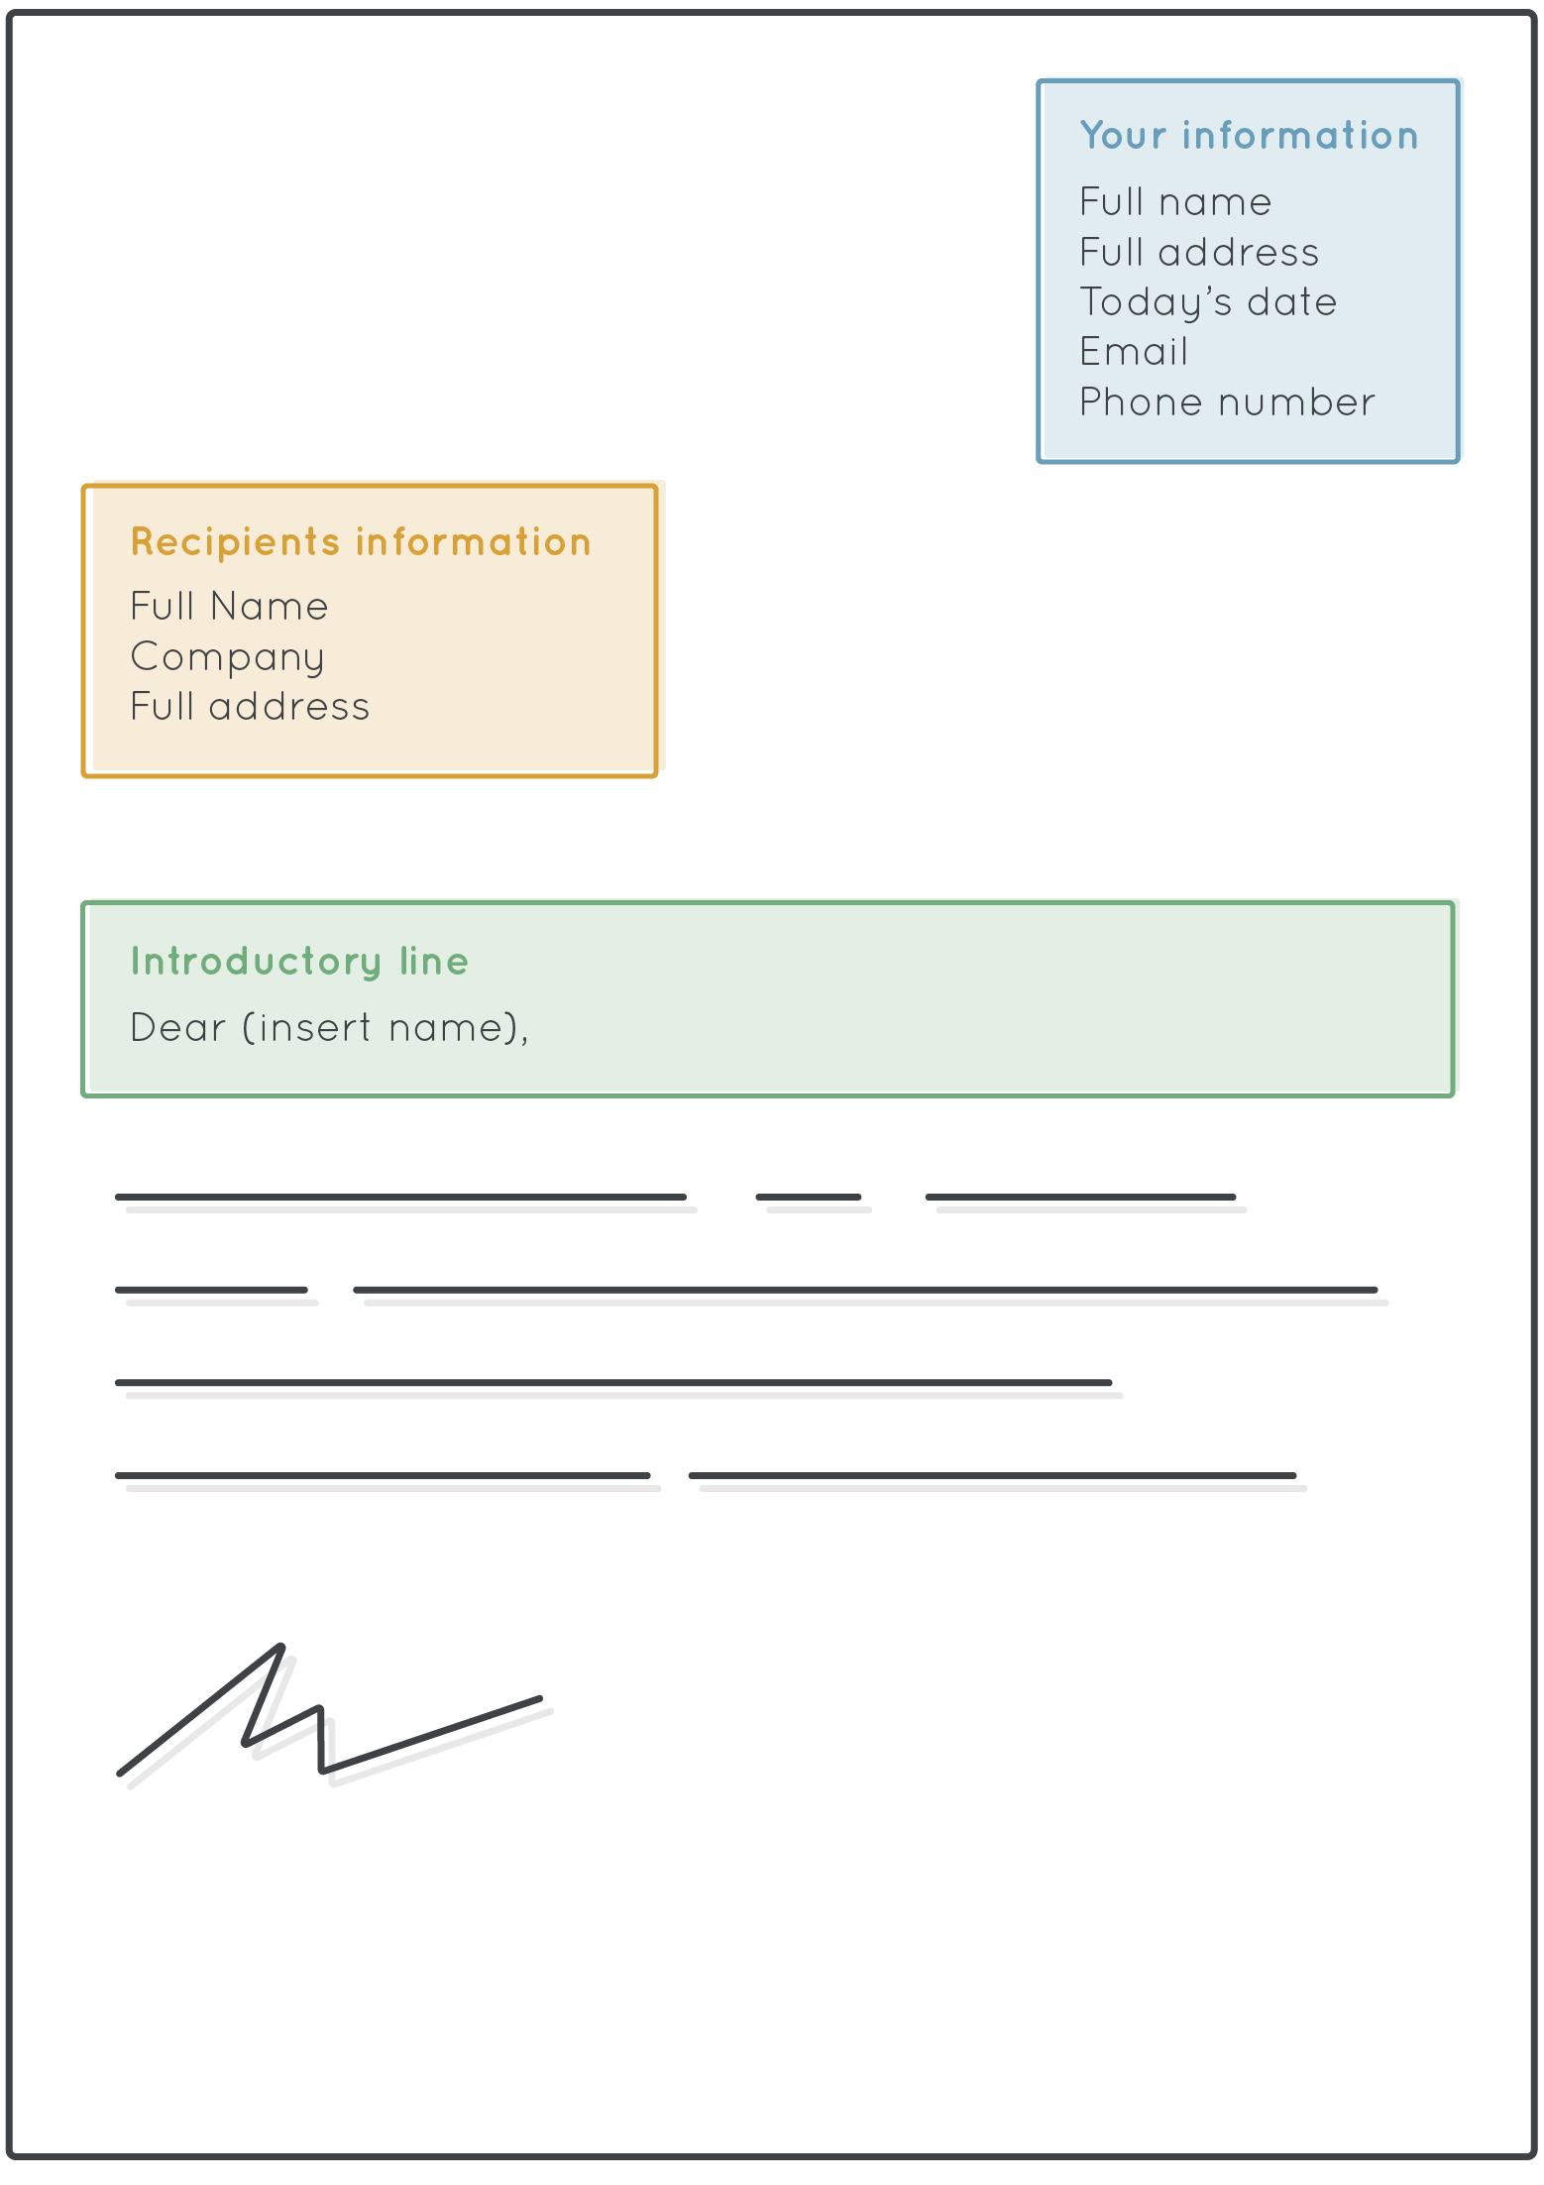
Letter format
Your name
Address
Date
Recipient's name
Address
Write your letter.
Create a first draft in your book.
Edit and improve.
What techniques can you include to make it better?
Create a final draft – it would be nice for you to share these with the person you have written them for so you could write on lined paper. You can also make envelopes and get creative!

