Slide 1
Good morning!
Monday
What’s the question?
Here is a list of answers. Your task is to write a suitable question for each answer!
green
Ipad
table
Christmas
clouds
sunflower
dentist
fire

Slide 2
Good morning!
Use an alphabet strip if you are finding this tricky!
Tuesday
Missing Letters
In each question write in the brackets either the missing numbers or the missing letters. Here is an example.
F , H , J , L , ( N ) , ( P )
1) A , Z , B , Y , ( ) , ( ) , D , W
2) S , Q , O , M , ( ) , ( )
3) A , O , B , N , C , M , D , ( ) , ( )
4) J , A , B , K , C , D , L , E , ( ) , ( )

Slide 3
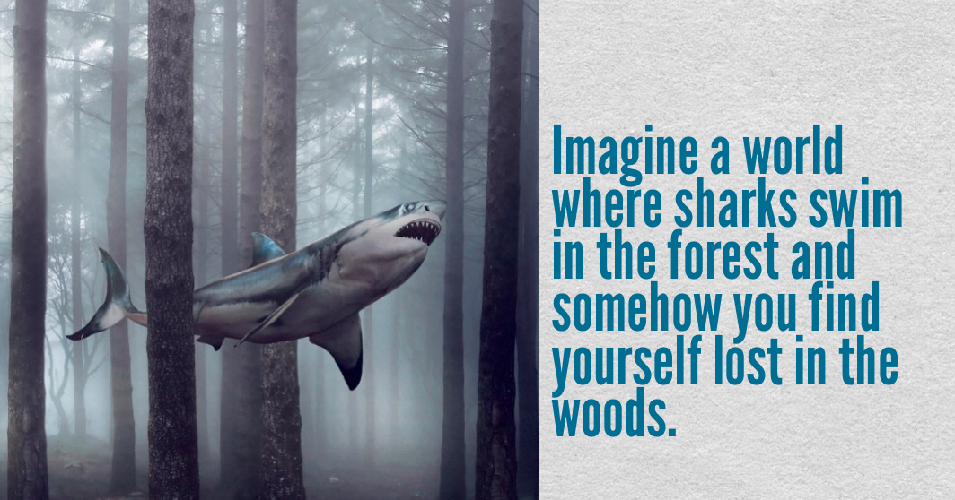
Good morning!
Wednesday
Write 5 sentences that describe the setting. Think about using sensory language. You must include:
1 simile or metaphor
2 expanded noun phrases
3 fronted adverbials
4 different types of punctuation

Slide 4
Good morning!
Thursday
Grab a pencil and draw what you “see”!
The human population in Africa has increased rapidly causing a growing demand for farmland. This demand for land has caused the natural habitat of elephants to shrink. As a result, elephants have less space to roam, meaning they come into contact with humans more frequently. People’s fields and crops are often disturbed by these wandering elephants, leading to conflict between humans and elephants. More often than not, it is the elephants who lose this conflict.

Slide 5

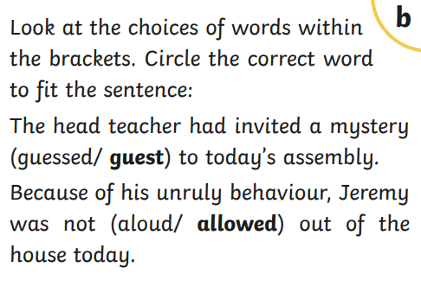
Good morning!
Friday
a) Can you solve this riddle?

