Slide 1
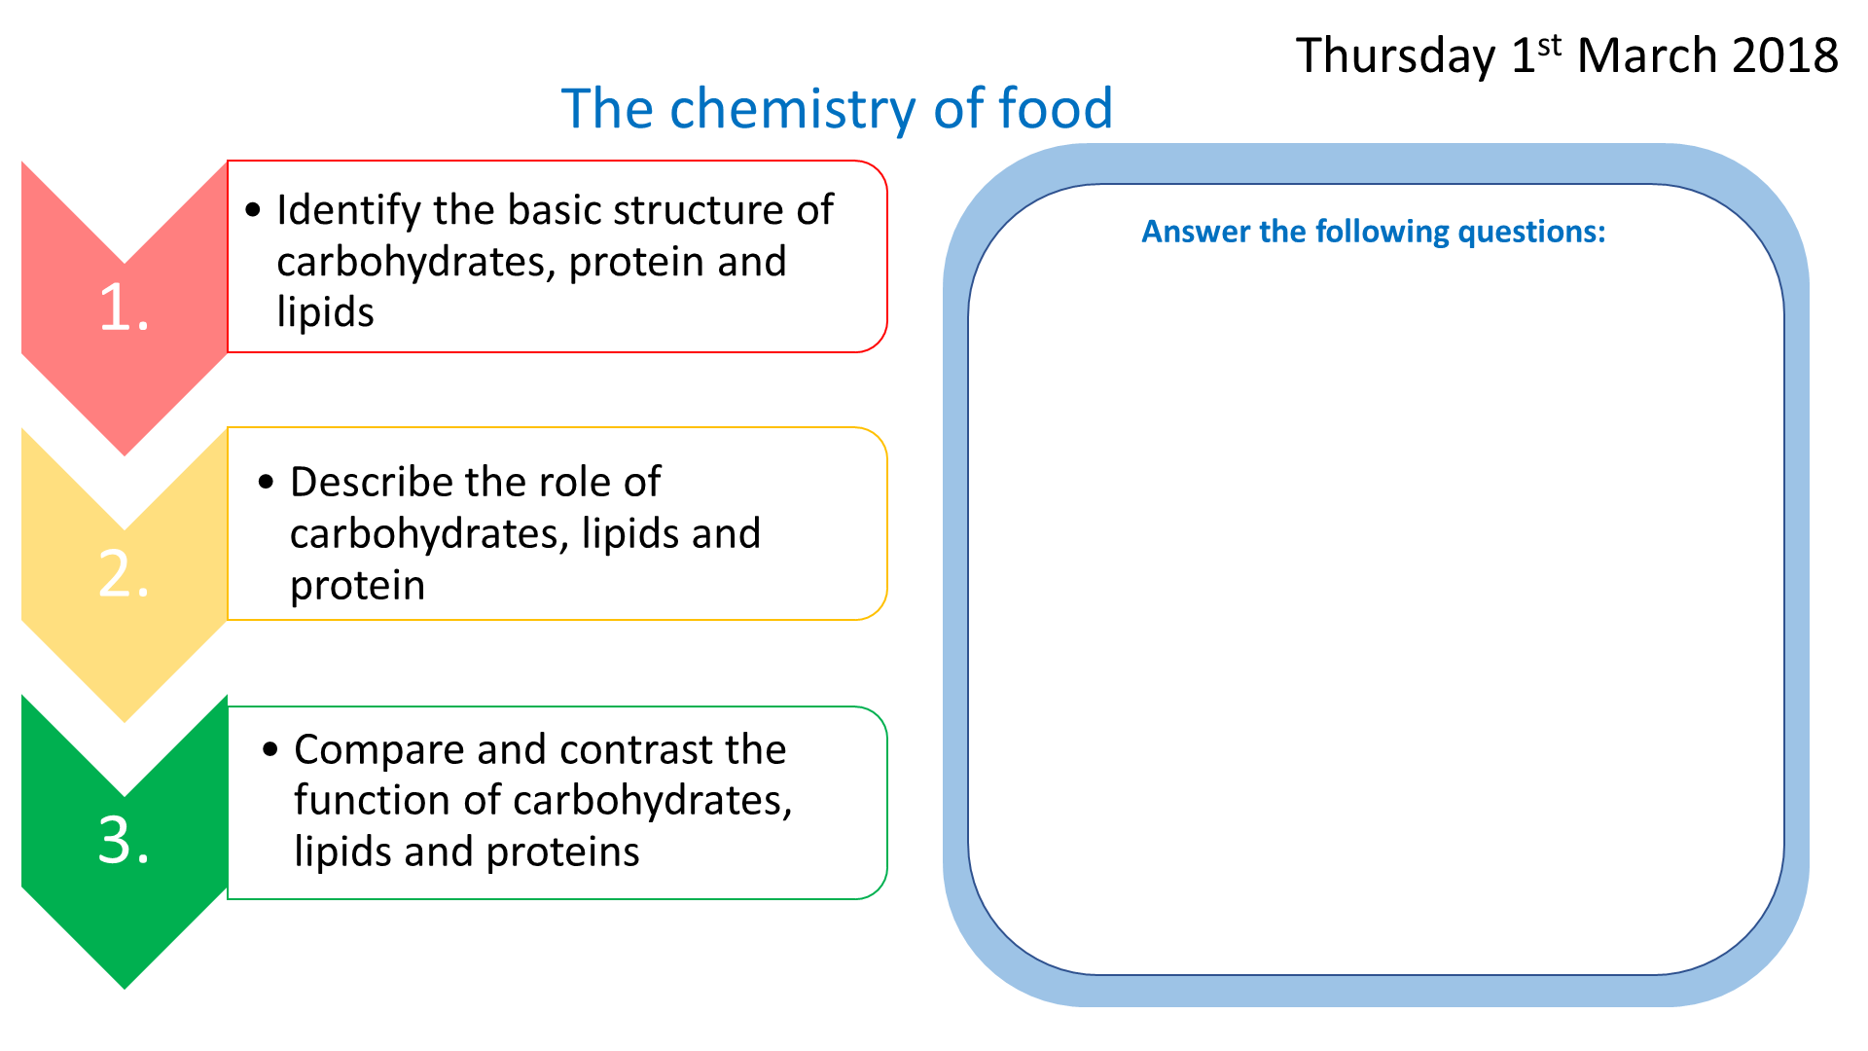
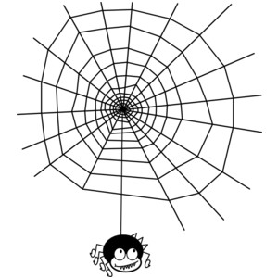
Monday 10th September 2018
Drugs
1.
2.
Describe the impact drugs and alcohol have on the body
Identify legal and illegal drugs
Starter: Draw a spider diagram to list as many drugs as you can think of…

Slide 2
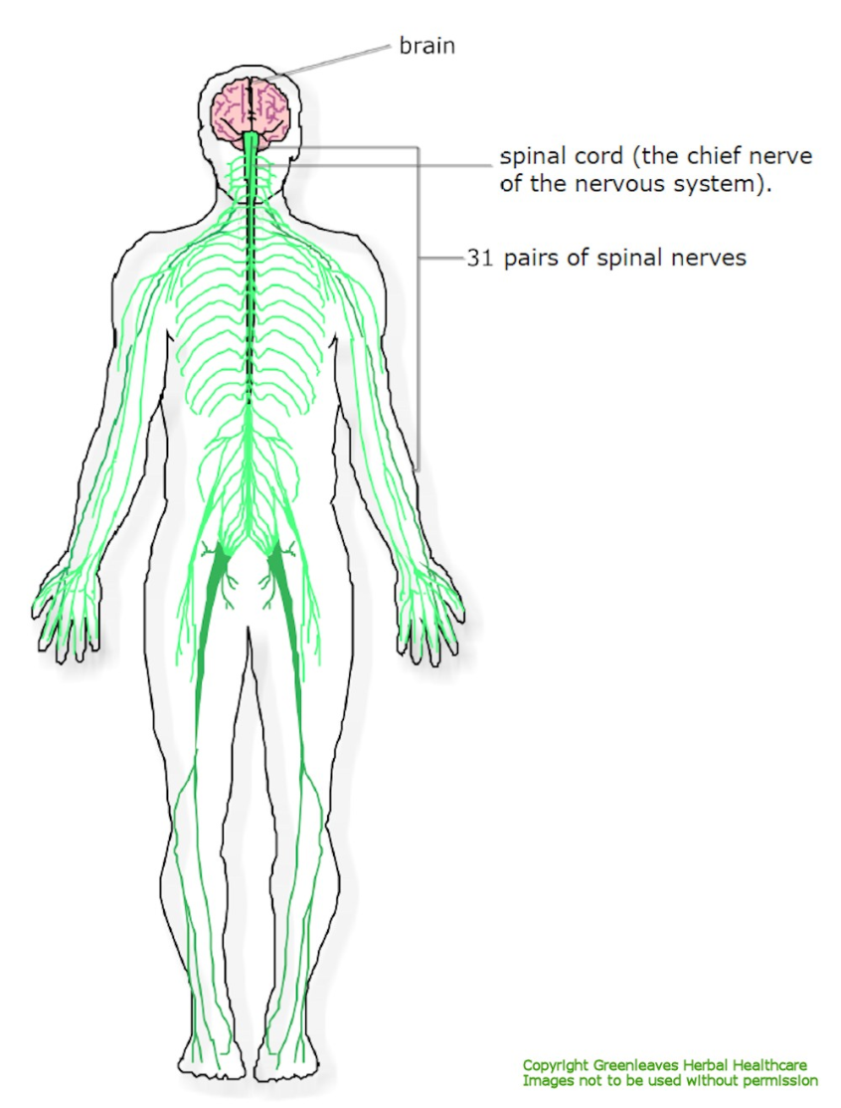
What are drugs?
Copy this!
A drug is any chemical substance that
affects the body’s central nervous system.

Slide 3
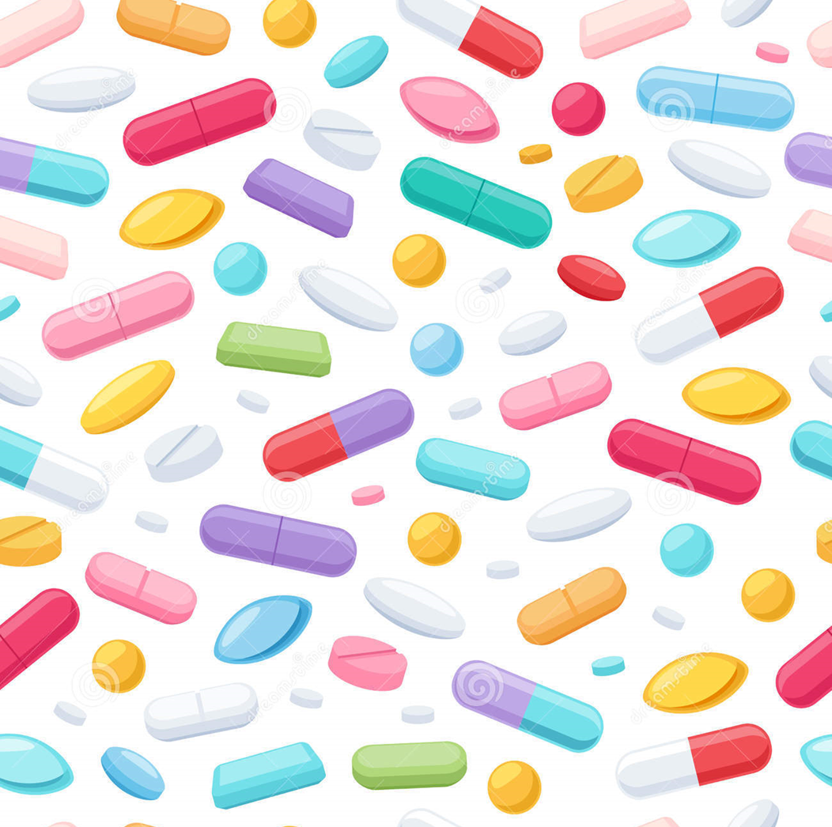
LEGAL OR ILLEGAL
Caffeine

Slide 4
LEGAL OR ILLEGAL
Heroin

Slide 5
LEGAL OR ILLEGAL
Paracetamol

Slide 6
LEGAL OR ILLEGAL
Nicotine

Slide 7
LEGAL OR ILLEGAL
Morphine

Slide 8
LEGAL OR ILLEGAL
Cannabis

Slide 9
LEGAL OR ILLEGAL
LSD

Slide 10
LEGAL OR ILLEGAL
Ecstasy

Slide 11
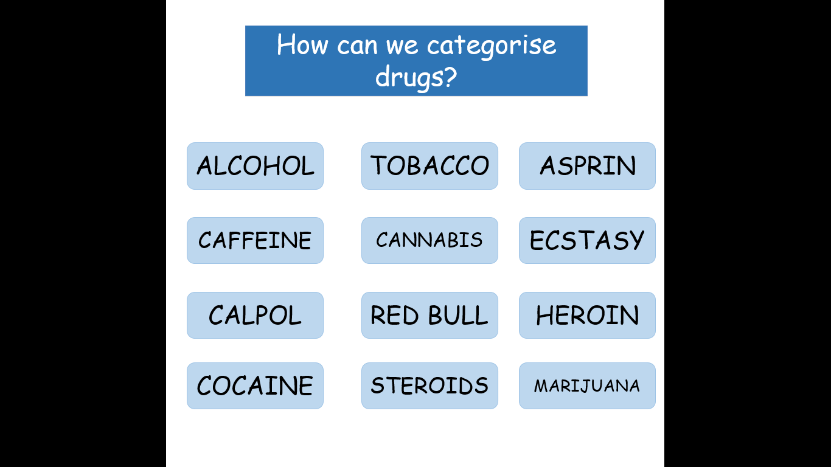
Learning
Check
Categorise the drugs into legal and illegal
self – assessment
LEGAL
ILLEGAL
ALCOHOL
TOBACCO
ASPRIN
CAFFEINE
CANNABIS
ECSTASY
CALPOL
RED BULL
HEROIN
COCAINE
STEROIDS
MARIJUANA

Slide 12

Illegal vs Legal
Illegal drugs are harmful.
They can have very bad side effects and can lead to addiction.
What does addiction mean?
Addiction – An addiction is a psychological need for something, which means you always want more.
If someone with an addiction stops taking drugs all of a sudden they suffer from withdrawl symptoms, which are very horrible.
Copy this!

Slide 13
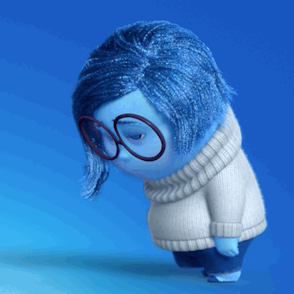
Depressants

Slide 14

Stimulants

Slide 15

Hallucinogens

Slide 16
Learning
Check
Fill in the following table
self – assessment
Organise these drugs into the correct category
KEY WORDS
Cannabis
LSD
Caffeine
Ketamine
ecstasy
sleeping tablets
Morphine
Magic mushroom
nicotine
Depressants | Stimulants | Hallucinogens
Sleeping tablets
Caffeine
LSD
Magic mushroom
Morphine
Nicotine
Cannabis
Ecstasy
Ketamine

Slide 17
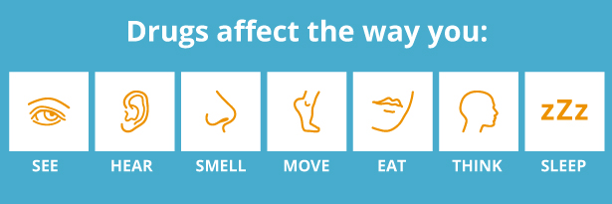
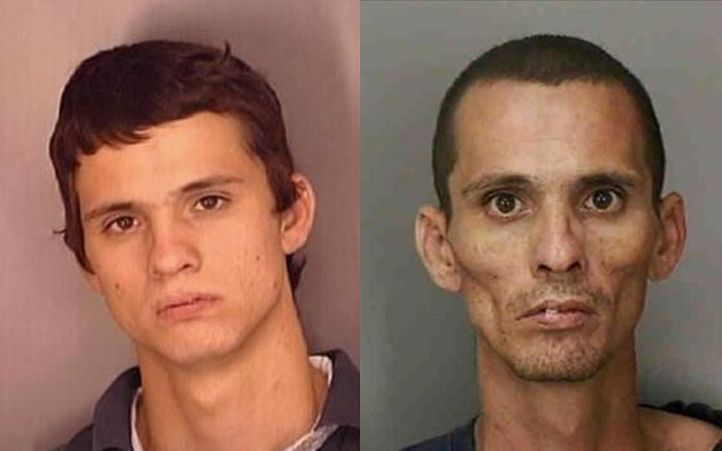
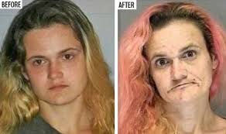
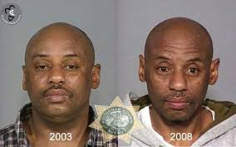
The horrible effects of drugs
If illegal drugs are bad, why do people take them?

Slide 18
Read the information on the different drugs and answer the following drugs
Identify the appearance
Describe the effects it has on the body
Explain the risks associated with the drugs
Compare and contrast 2 different types of drugs

Slide 19
Plenary
This lesson I learnt…..
I can improve my understanding by…..

Slide 20
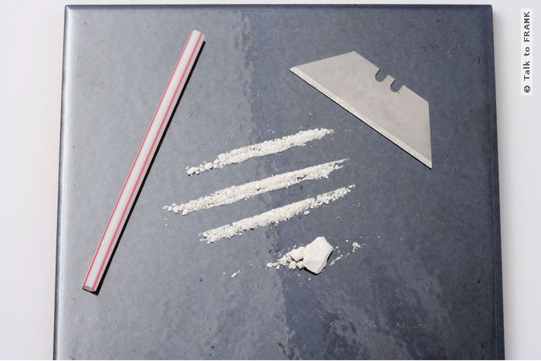


Cocaine
Risks
After a big night on cocaine, it's not unusual for people to feel like they've got the flu.
Some people are over-confident on it and so may take very careless risks.
Using cocaine a lot makes people feel depressed and run down.
Appearance
Cocaine is a white powder.
Law
Cocaine and crack are Class A drugs - illegal to have, give away or sell.
Possession can get you up to seven years in jail.
Supplying someone else, including your friends, can get you life and an unlimited fine.
Effects
Cocaine is a stimulant, so it can raise the body’s temperature, make the heart beat faster.
The effects last around 20-30 minutes.

Slide 21
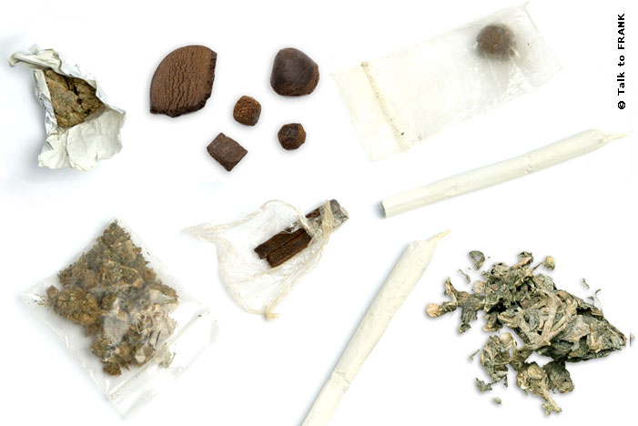
Cannabis
Risks
Cannabis itself can affect many different systems in the body, including the heart: increasing the heart rate and affecting blood pressure.
Even hardcore smokers can become anxious, panicky, suspicious or paranoid.
Cannabis affects your coordination, which is one of the reasons why drug driving is just as illegal as drink driving.
If you use cannabis and have a family background of mental illness you may be at increased risk of developing a psychotic illness.
Appearance
Cannabis can either come as a green plant or a black resin.
Effects
Some people may feel chilled out, relaxed and happy, while others have one puff and feel sick.
Others get the giggles and may become talkative.
Hunger pangs are common and are known as 'getting the munchies'.
Users may become more aware of their senses or get a feeling of slowing of time, which are due to its hallucinogenic effects.
Law
Cannabis is a class B drug, if in possession it can result in a road side caution or a fine.
For persistent offenders or dealers a jail sentence is possible.

Slide 22

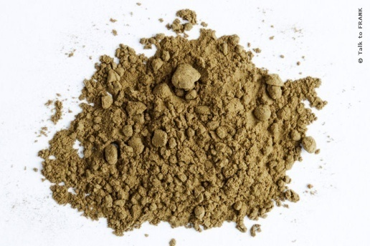
Risks
Deaths from overdoses occur.
Overdoses can lead to coma and even death from respiratory failure.
If heroin is taken with other drugs, including alcohol, overdose is more likely.
There's also a risk of death due to inhaling vomit.
Injecting heroin can do nasty damage to your veins.
The risks of sharing needles puts you in danger of infections like HIV/AIDS.
Appearance
Heroin comes as a white or brown powder.
Heroin
Effects
Heroin slows down body functioning and substantially reduces physical and psychological pain.
Most users get a rush or buzz a few minutes after taking it.
A small dose of heroin gives the user a feeling of warmth and well-being.
Bigger doses can make the user sleepy and very relaxed.
The first dose of heroin can bring about dizziness and vomiting.
Law Heroin is a class A drug. This means that possessing it can lead to a prison sentence of up to 7 years and an unlimited fine. Supplying (which includes giving it to a friend) could lead to a life sentence and another unlimited fine.

Slide 23
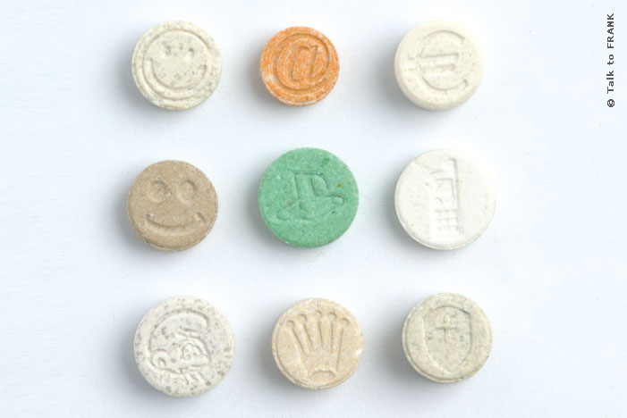
Ecstasy
Appearance
Ecstasy usually comes in pill form or as a white powder.
Risks
Physical side effects can develop that include: dilated pupils, a tingling feeling, tightening of the jaw muscles, raised body temperature and the heart beats faster.
Short-term effects of use can include anxiety, panic attacks, confused episodes and paranoid or psychotic states.
There’s no way of telling what’s in an E until you've swallowed it. So, there may be negative side effects from other ingredients in the tablet.
E’s can make users feel a bit down after use
Law
Ecstasy is a Class A drug - illegal to have, give away or sell. Possession can get you up to seven years in jail. Supplying someone else, including your friends, can get you life and an unlimited fine.
Effects
An E gives people an energy buzz that makes them feel alert and alive – sounds and colours are more intense. Users often feel great love for the people they're with and the strangers around them.
On its own, it’s not a drug that makes people violent. Lots of people feel chatty on E. (These chats don't always make sense to people who aren't on an E).

