Slide 1
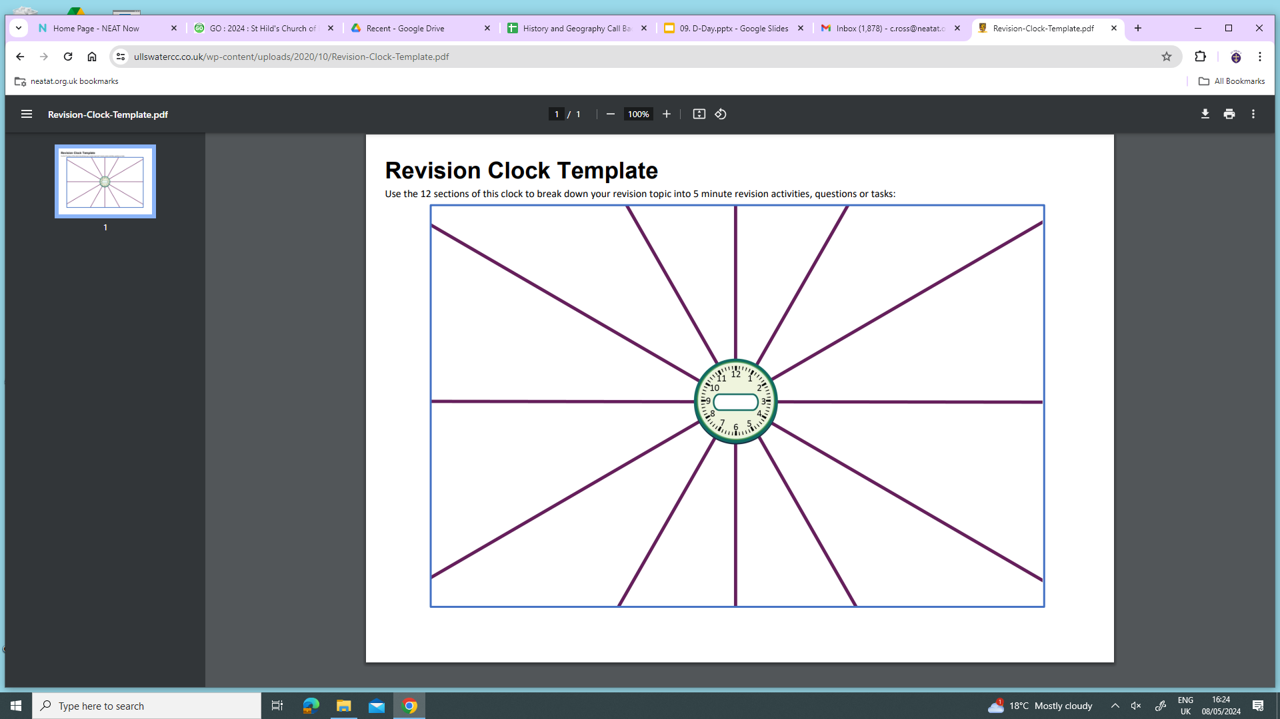
Law enforcement
Punishments
Crimes
Law enforcement
Crimes
Punishments
Punishments
Crimes
Law enforcement
Crimes
Punishments
Law enforcement

Slide 2
Social Reformers and George Peabody
Role of the media
Housing
Poverty
Jack the Ripper and failures
Unemployment
Detective techniques and CID
Workhouse
Police organisation
The Beat
Immigration
Crime
Notes:
Recommended to use alongside the BBC Jack the Ripper documentary

Slide 3
1088 Succession Crisis
Anglo-Saxon Life
Norman Life
Succession crisis 1066
The Church
Battles of 1066
Feudal System
Submission of the earls
Rebellions and uprisings
Domesday Book
Castles
Marcher Earldoms

Slide 4
Wounded Knee Massacre
Destruction
Early settlement
Manifest Destiny
Battle of Little Bighorn
Laws to remove land
Conflict with the Plains Indians
Mormons
Ranchers vs Homesteaders
Homestead Act 1862
Migration- push and pull
Cowboys
Notes:
https://www.youtube.com/playlist?list=PL9bgSdxfgbwqo7t47itzA1ARXcg4-CVcI

Slide 5
Jews
Opposition
Weimar Germany
Rebellions
Children
Gustav Stresemann
Women
Golden Age
Terror and Propaganda
Early Nazi Party
Dictator
Chancellor

Slide 6
Reagan and the Second Cold War
Gorbachev
Features of a Cold War
Post 1945- the conferences
Detente 1970’s
Soviet Expansion
Cuban Missile Crisis
Truman Doctrine, NATO and the Berlin Blockade
The Hungarian Crisis
The Arms Race and the Space Race
Czechoslovakia Crisis
Berlin Wall Crisis

