Slide 1
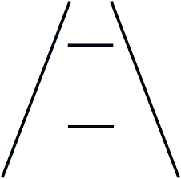
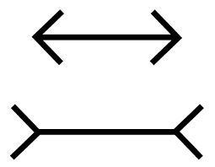
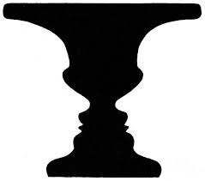
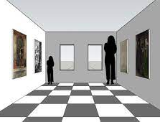
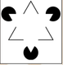
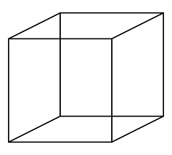


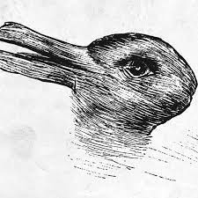
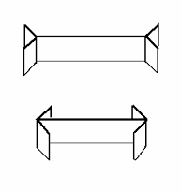
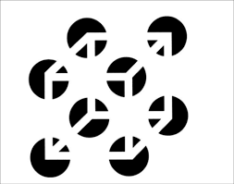
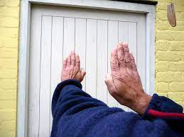
Key terms
Examples of visual illusions
Perception knowledge organiser
Key term | Definition
Sensation
Perception
Visual cues
Visual constancies
Monocular depth cues: | Height in plane:
 | Linear perspective:
 | Occlusion:
 | Relative size:
Binocular depth cues: | Retinal disparity:
 | Convergence:
Visual illusion | The ponzo | Müller-Lyer | Rubin’s vase | The Ames room | Kanizsa triangle | Necker cube
Picture
Description and explanation
Gibson – NATURE
Sufficient information for direct perception
Optic flow patterns
Motion parallax
Nature
Evaluating Gibson’s theory
☺ ☹
Theories of perception
Gregory – NURTURE
Perception is a construction
Inference
Visual cues
Nurture
Evaluating Gregory’s theory
☺ ☹
Explaining visual illusions
1) Ambiguity | 2) Misinterpreted depth cues
3) Fiction | 4) Size constancy
Factors affecting perception
Culture | Motivation | Emotion | Expectation
☺ ☹ | ☺ ☹ | ☺ ☹ | ☺ ☹

Slide 2

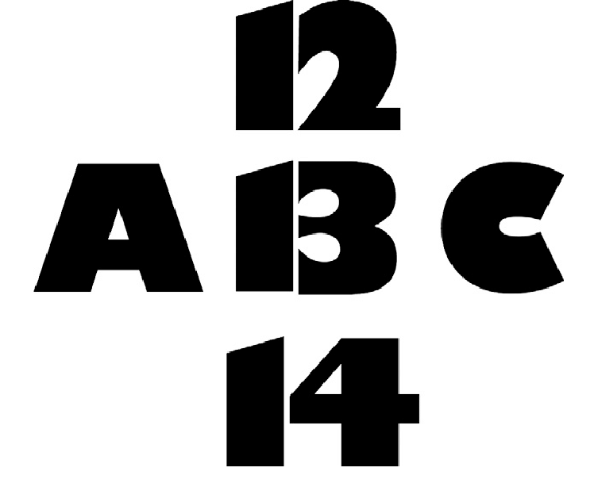
Gilchrist and Nesberg (1952) Factors affecting perception: Motivation
Aim
Procedure
Findings
Conclusion
Evaluation: GRAVE
Bruner and Minturn (1955) Factors affecting perception: Expectation
Aim
Procedure
Findings
Conclusion
Evaluation: GRAVE

